Slide 1
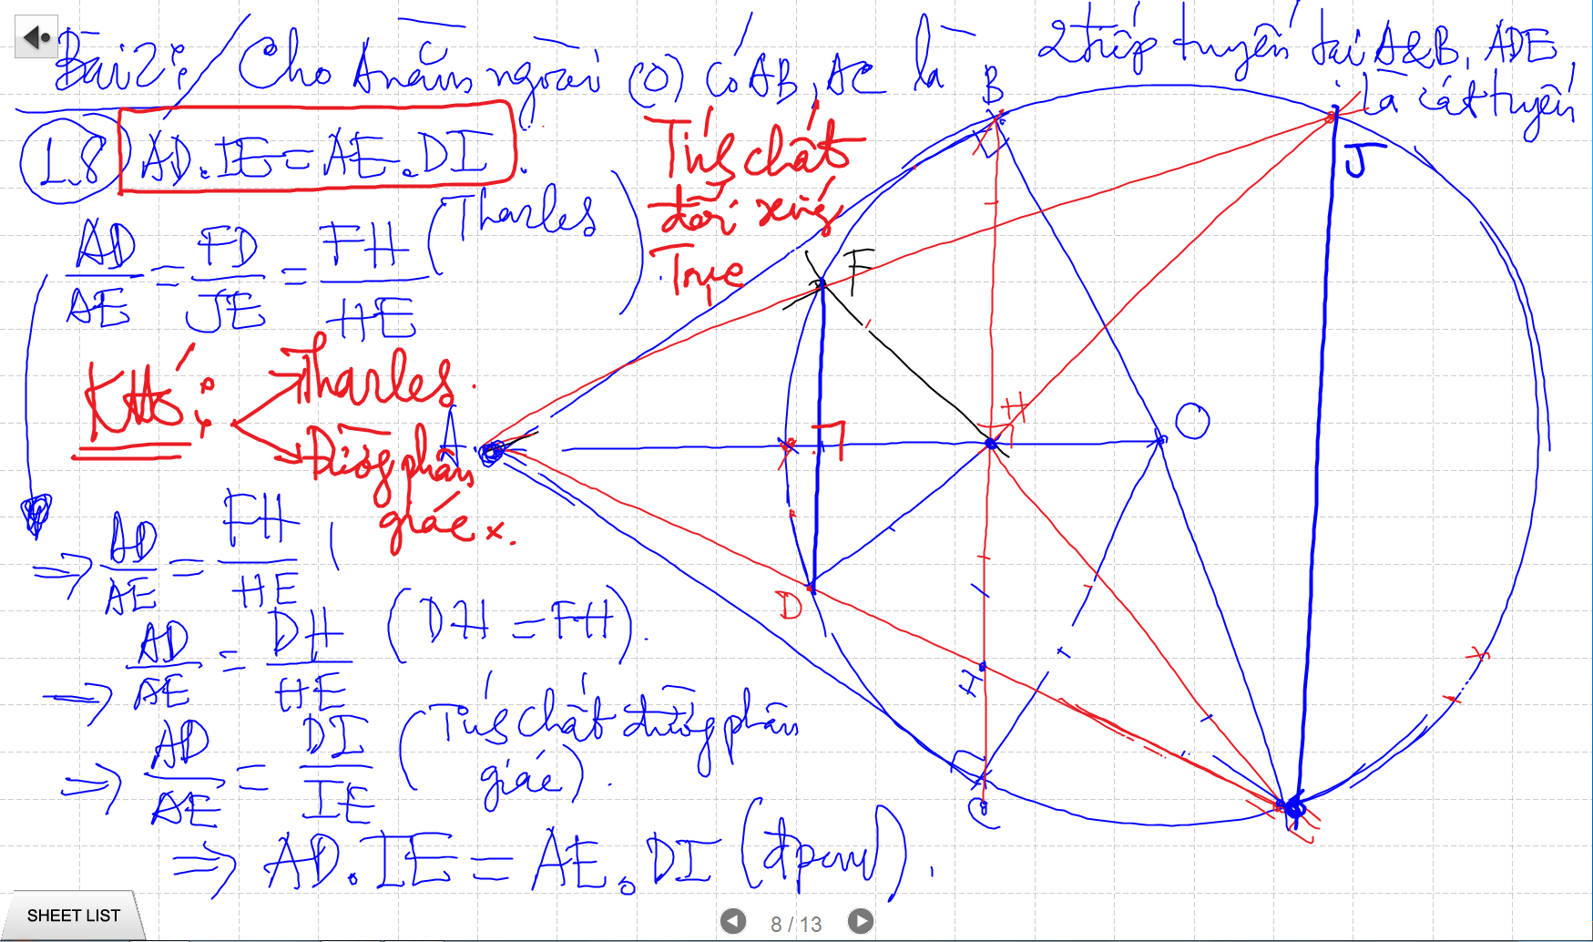
CAC CHUYEN DE
BIEN DOI DAI SO
TINH SO DO GOC, DO DAI DAY CUNG
THANG HANG

Slide 2
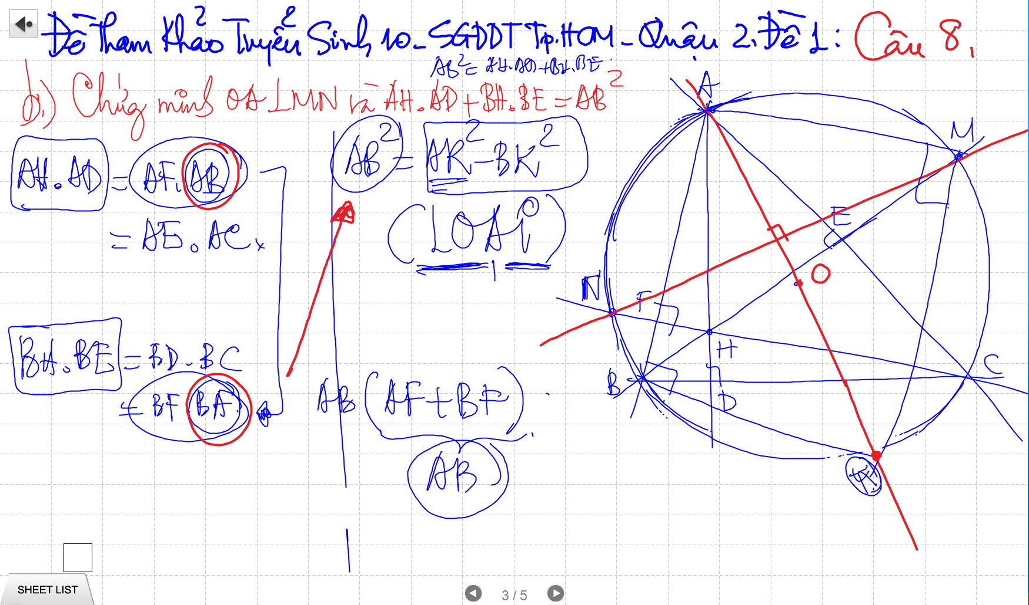
CAC CHUYEN DE
BIEN DOI DAI SO
TINH SO DO GOC, DO DAI DAY CUNG
THANG HANG

Slide 3
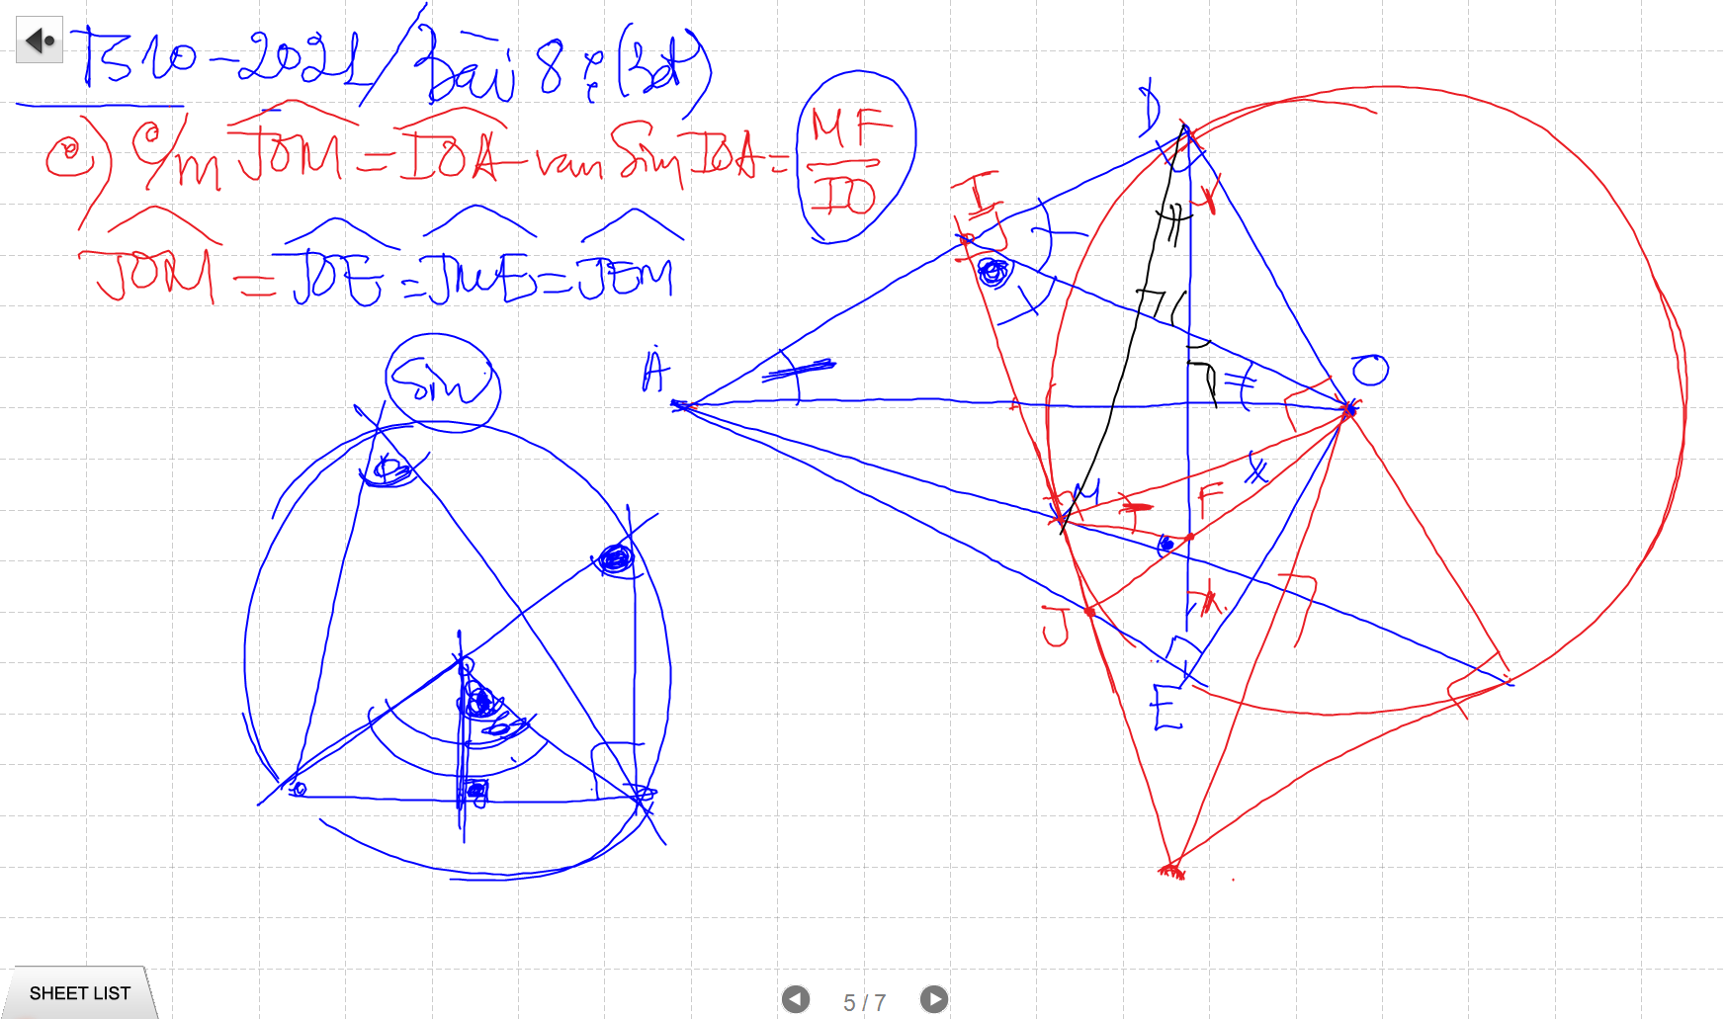
CAC CHUYEN DE
BIEN DOI DAI SO
TINH SO DO GOC, DO DAI DAY CUNG
THANG HANG

Slide 4
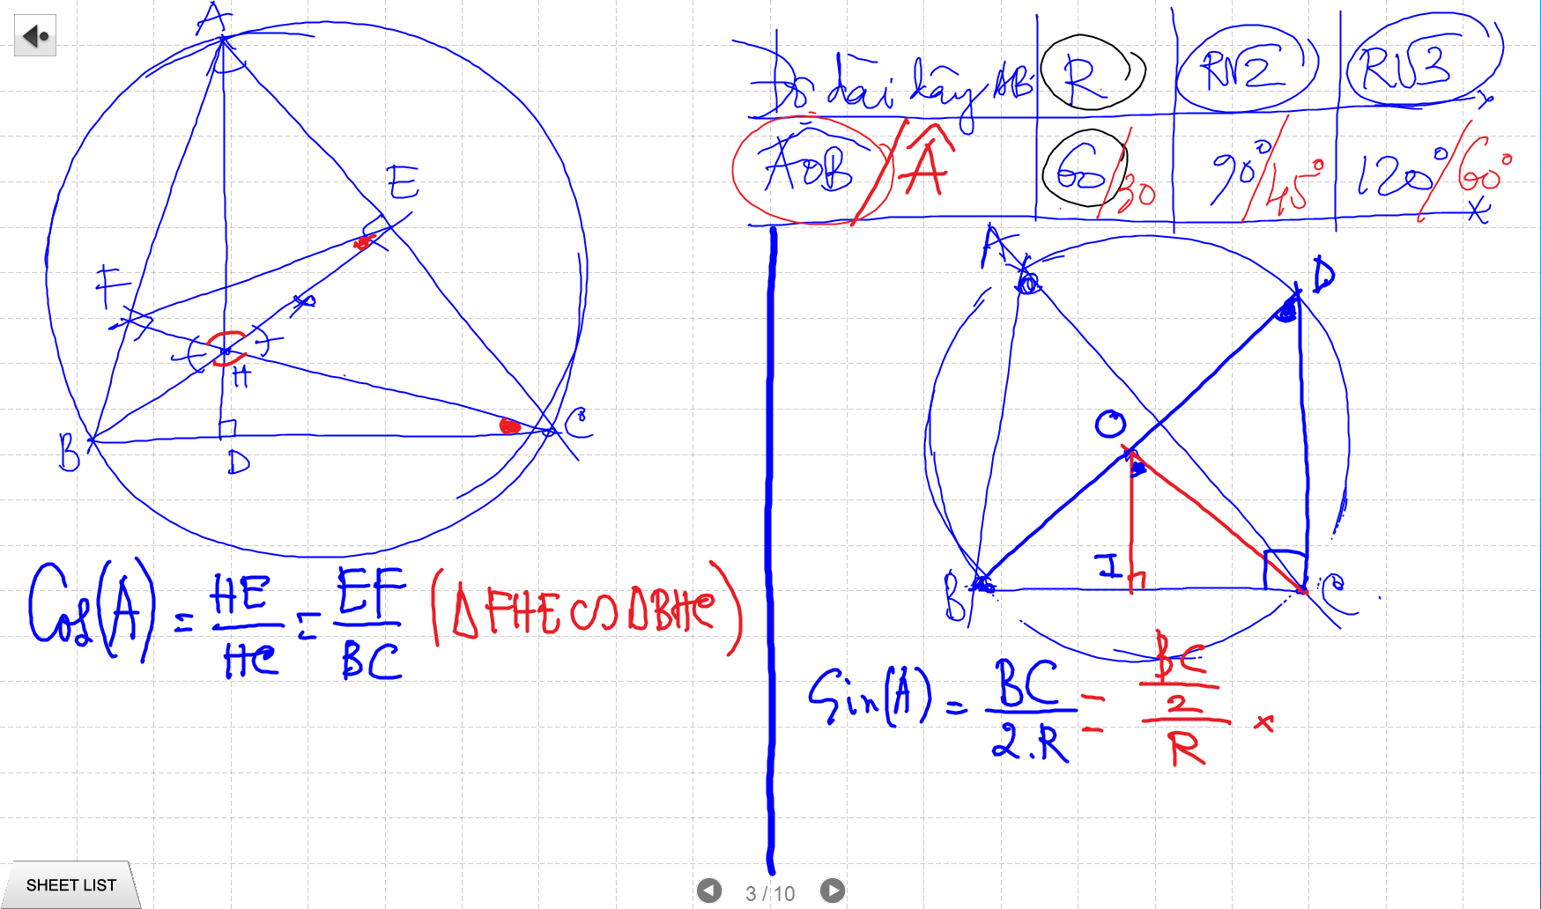
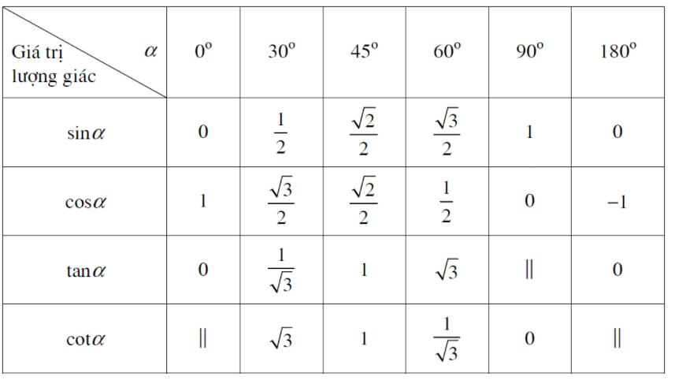
TINH SO DO GOC
Bai 1 – 7 De Cuong (don gian)

Slide 5
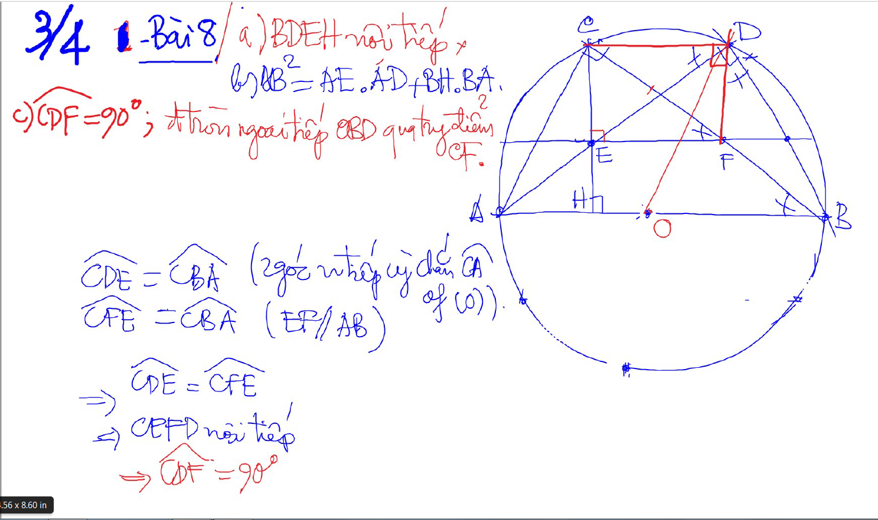
BIEN DOI DAI SO

Slide 6
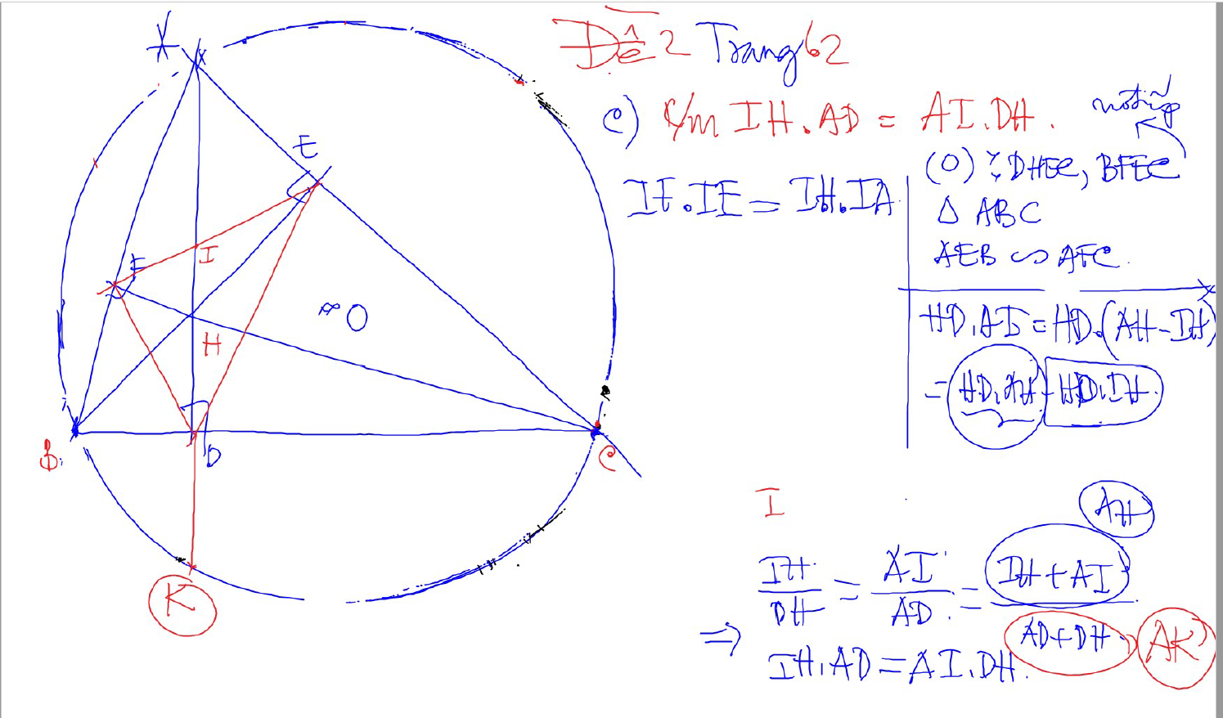
BIEN DOI DAI SO

Slide 7
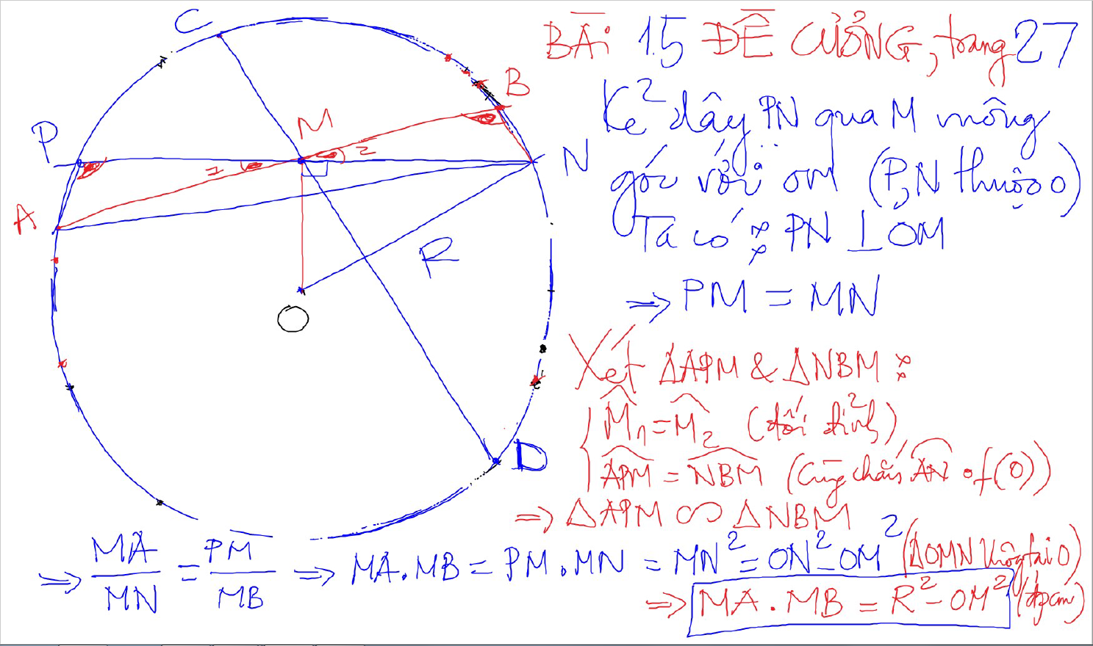
BIEN DOI DAI SO

Slide 8
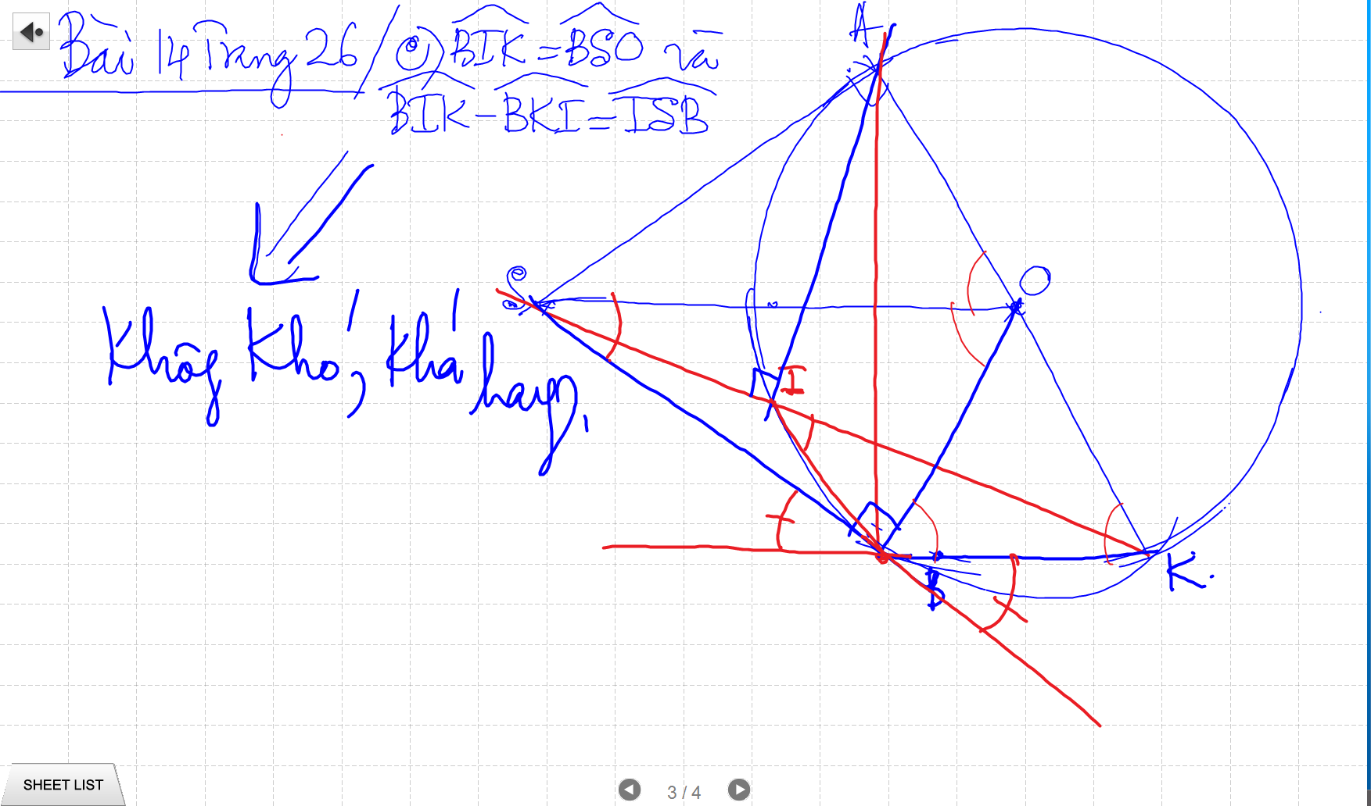
BIEN DOI DAI SO

Slide 9
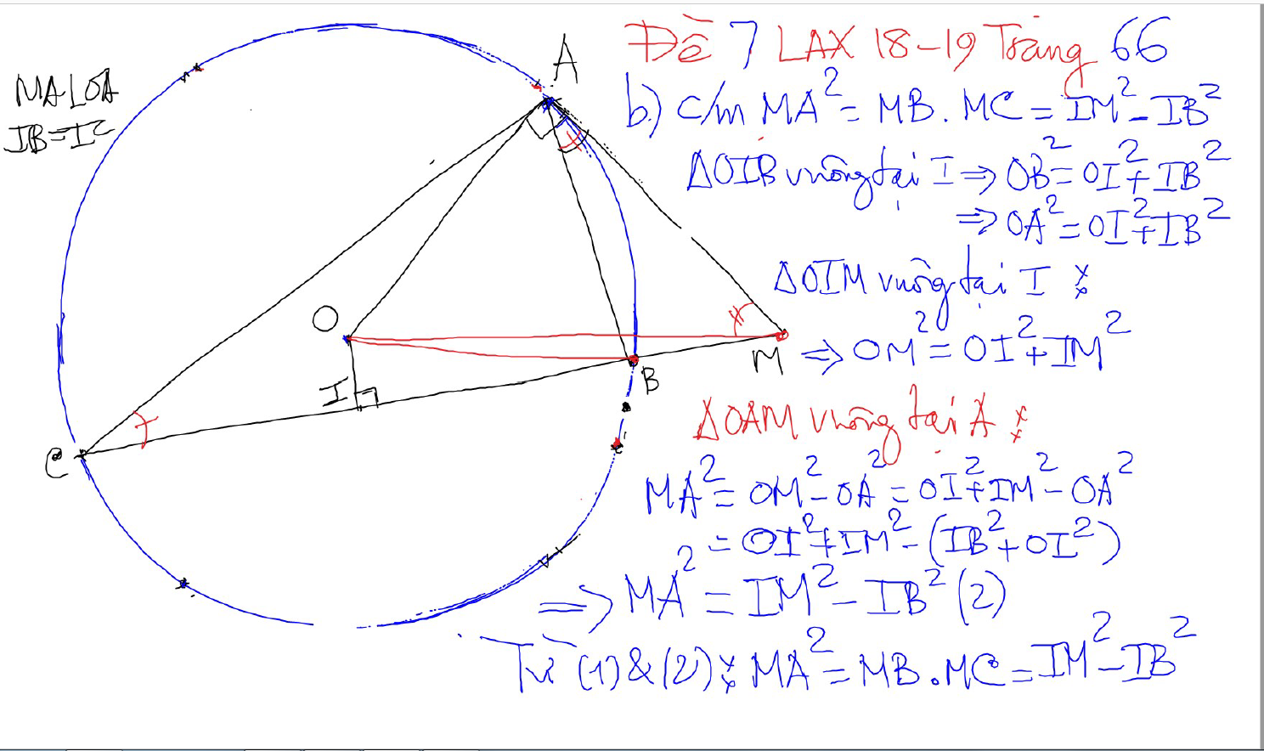
BIEN DOI DAI SO

Slide 10
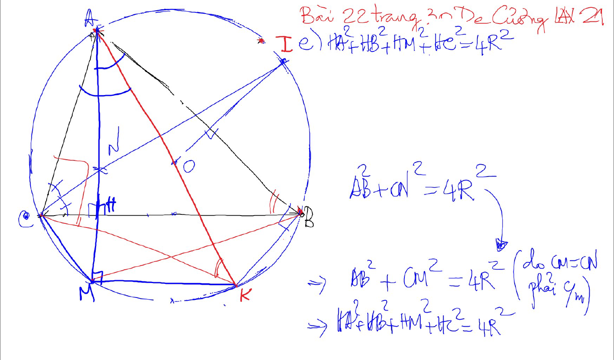
BIEN DOI DAI SO

Slide 11
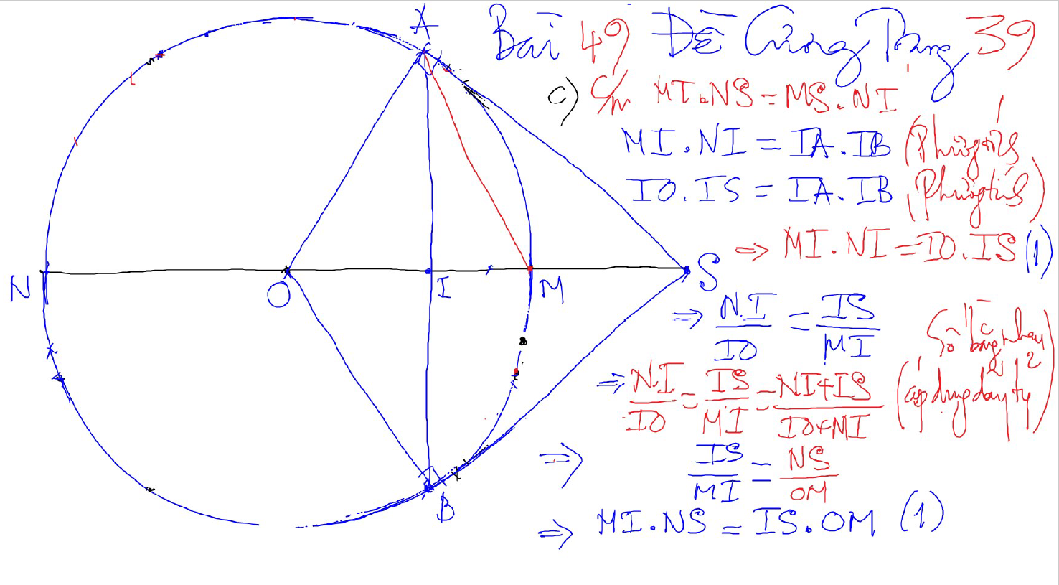
BIEN DOI DAI SO

Slide 12
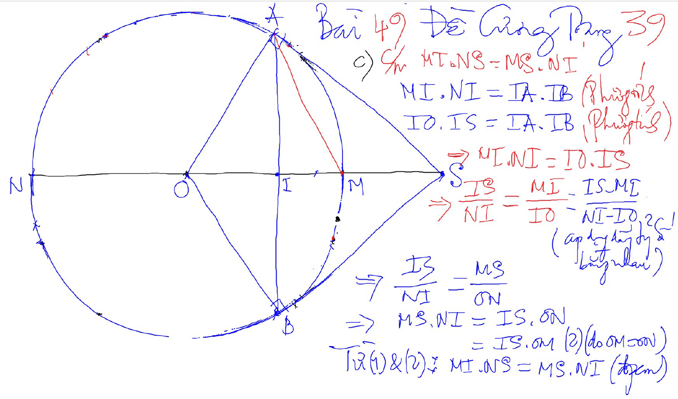
BIEN DOI DAI SO

Slide 13
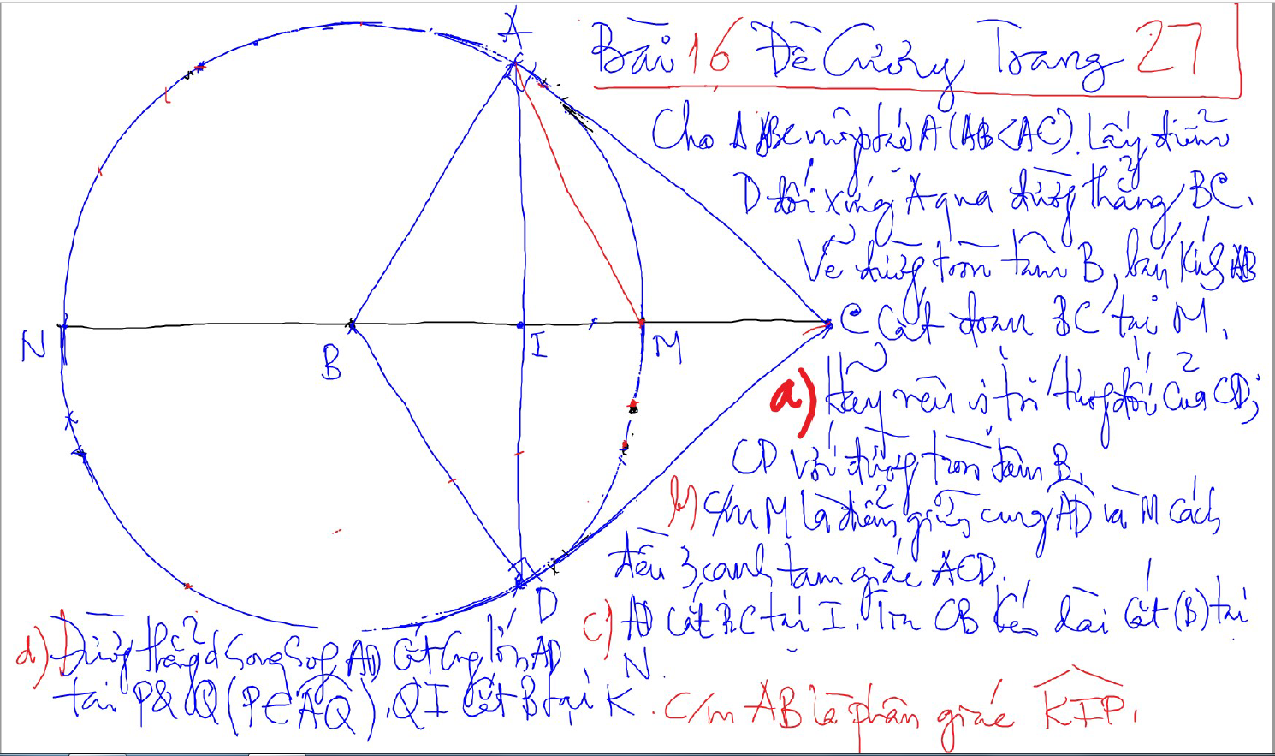
BIEN DOI DAI SO

Slide 14
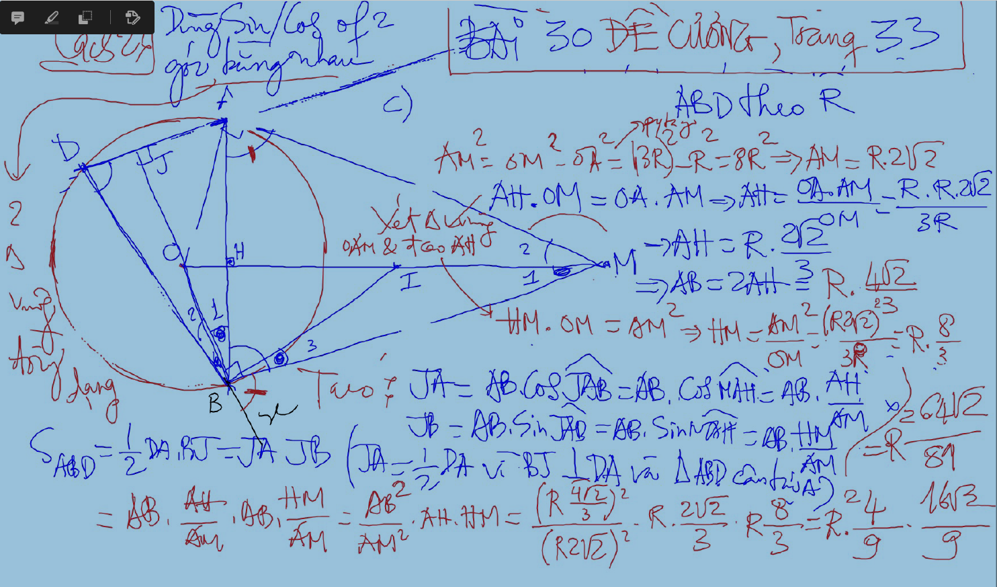
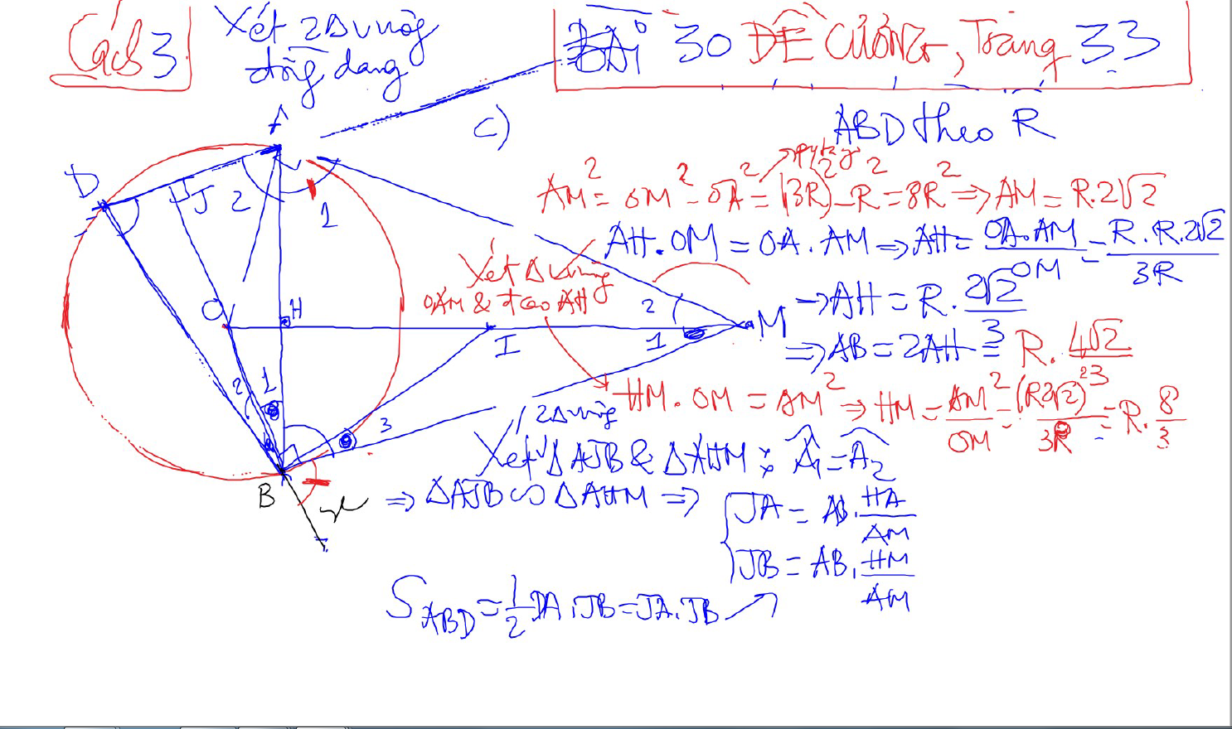
BIEN DOI DAI SO

Slide 15
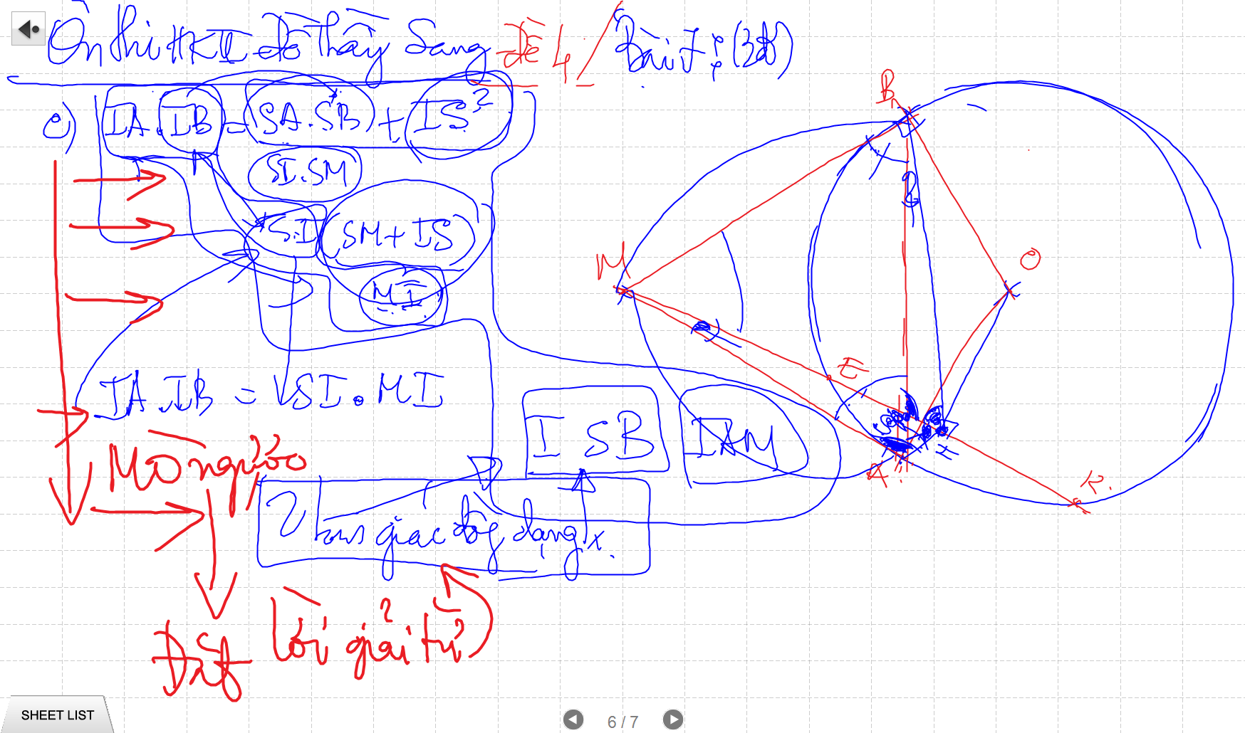
BIEN DOI DAI SO

Slide 16
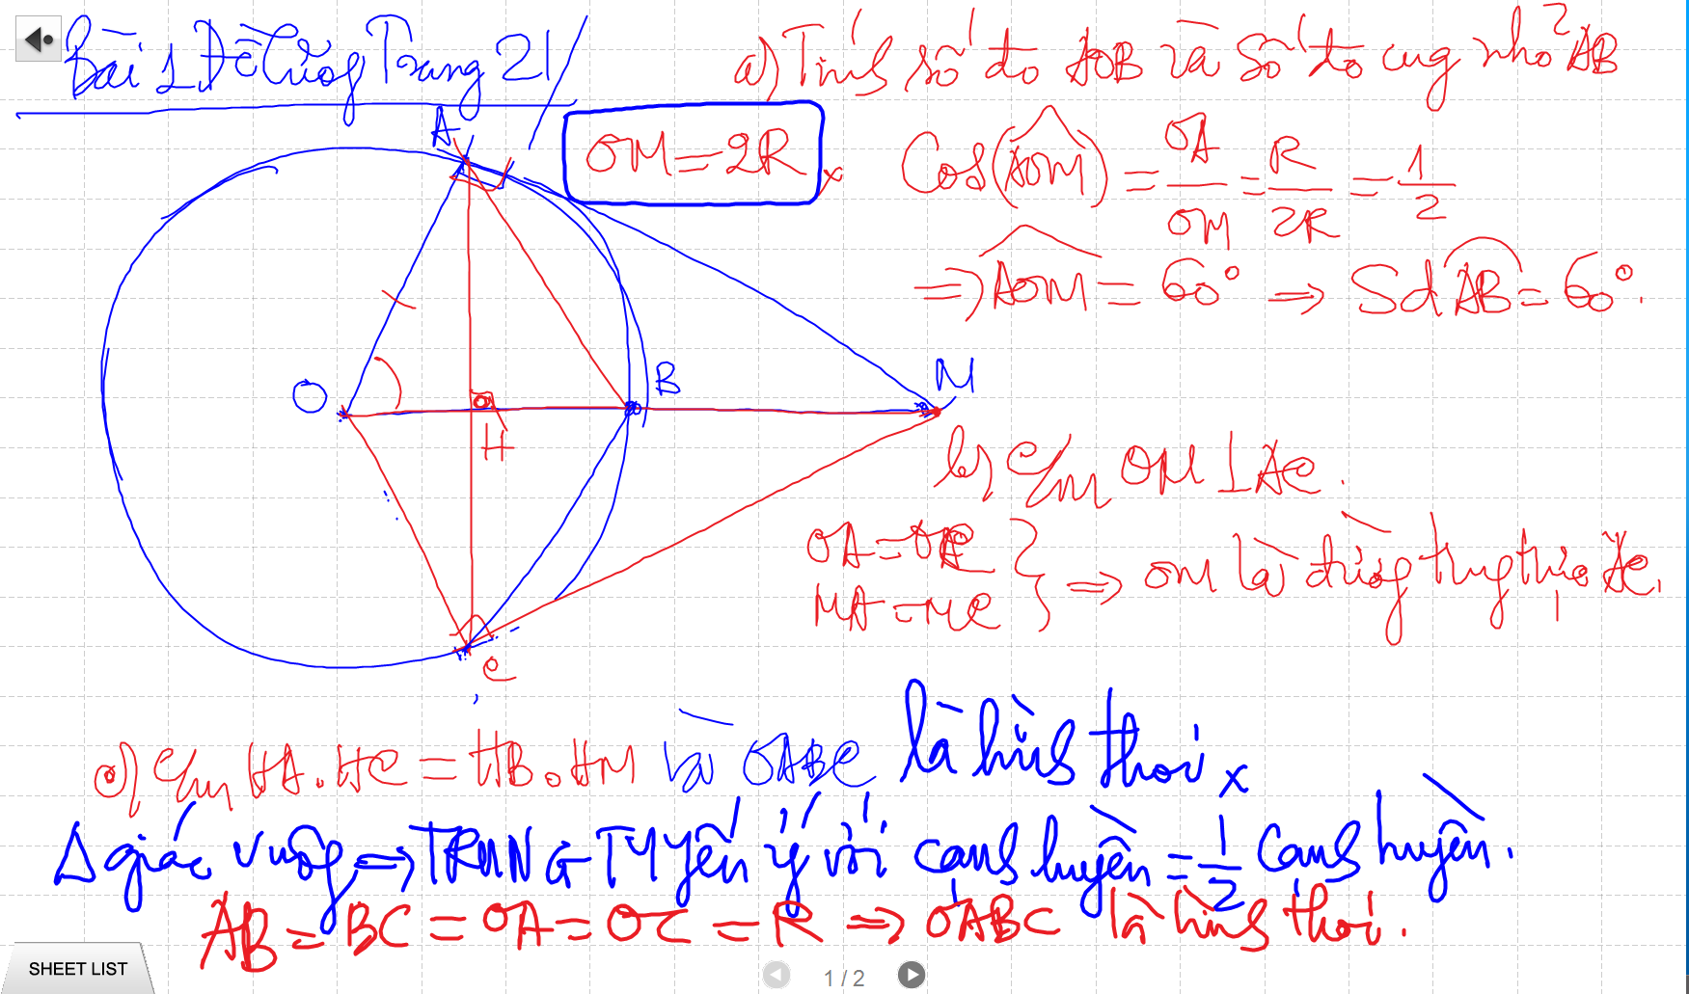
TINH SO DO GOC

Slide 17
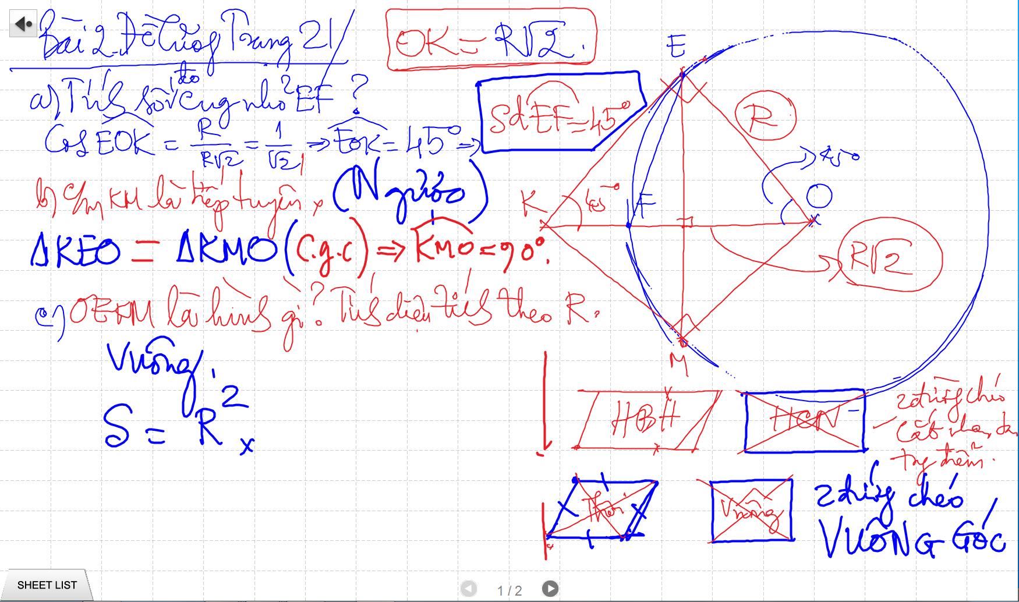
TINH SO DO GOC

Slide 18
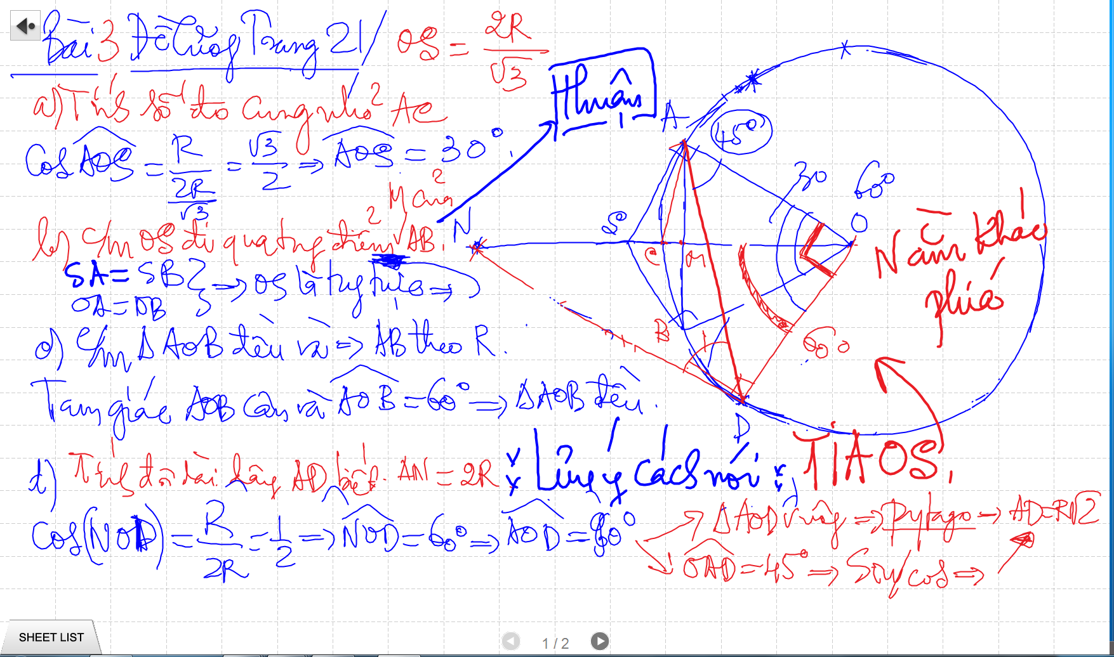
TINH SO DO GOC

Slide 19
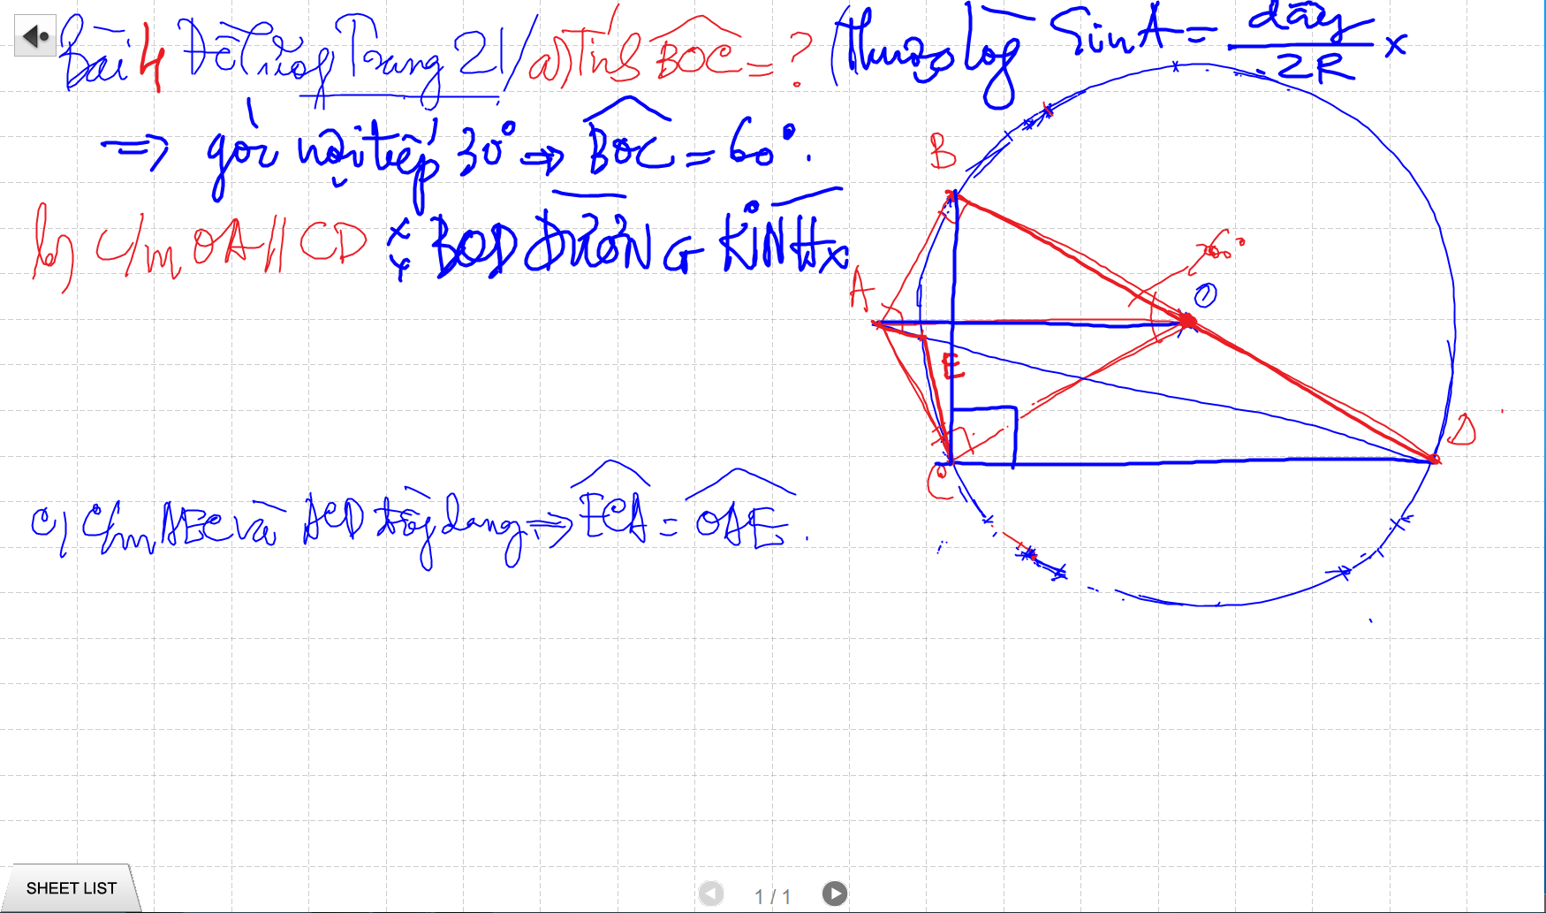
TINH SO DO GOC

Slide 20
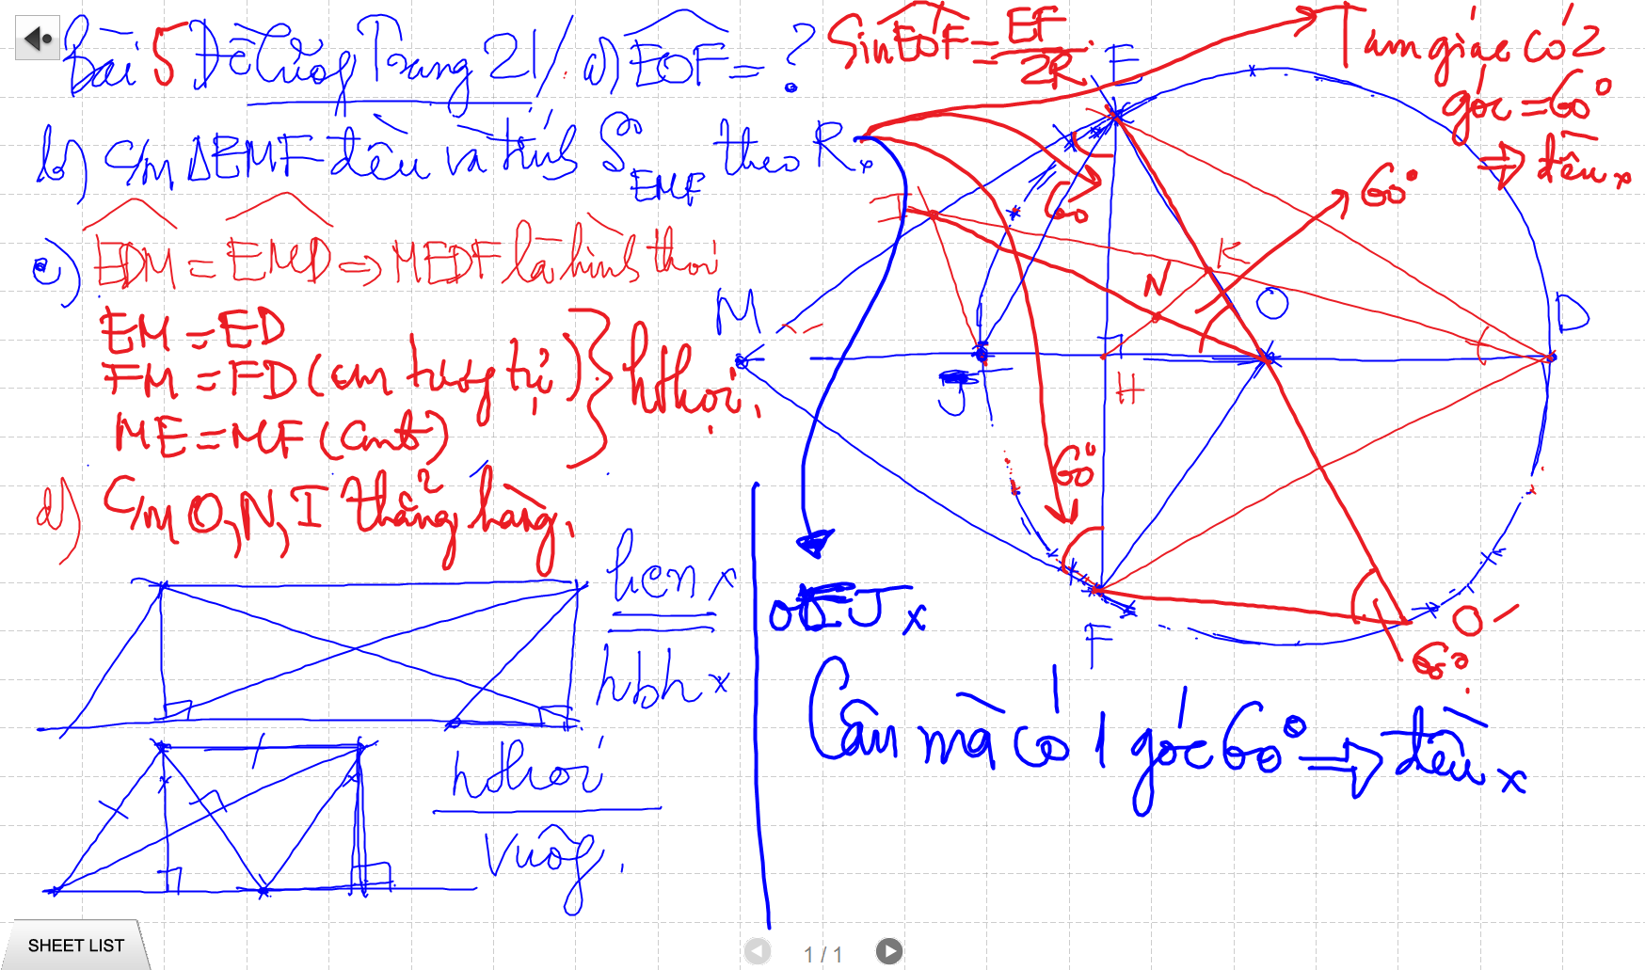
TINH SO DO GOC

Slide 21
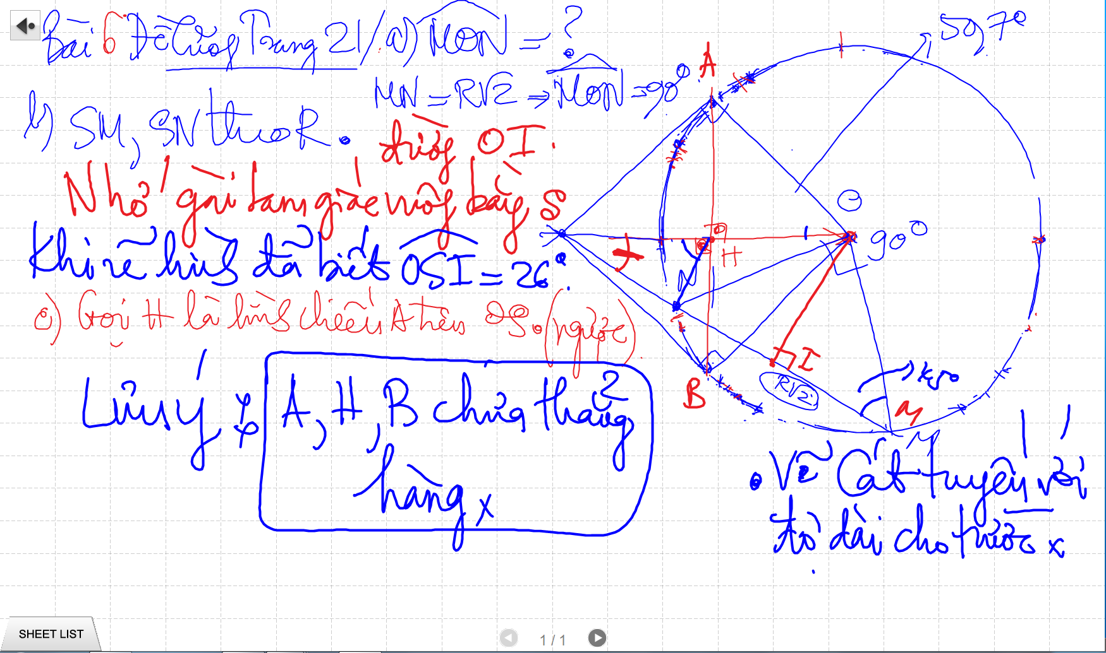
TINH SO DO GOC

Slide 22
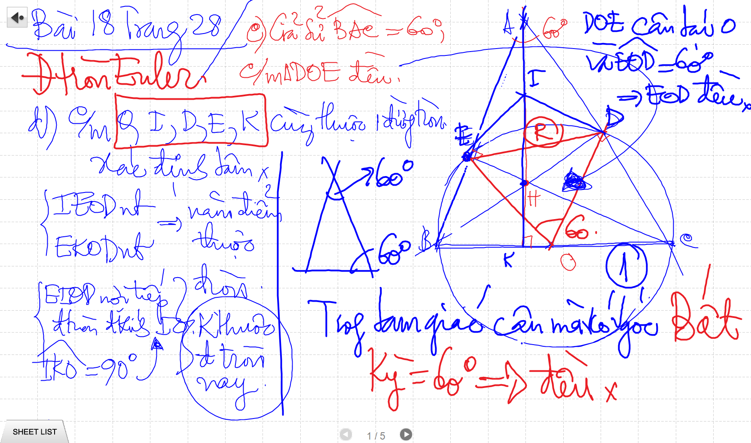
TINH SO DO GOC

Slide 23
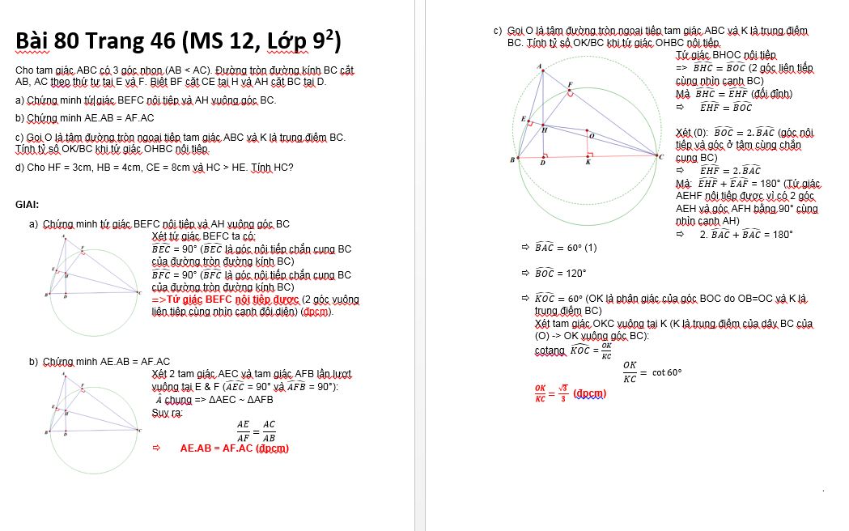
TINH SO DO GOC

Slide 24
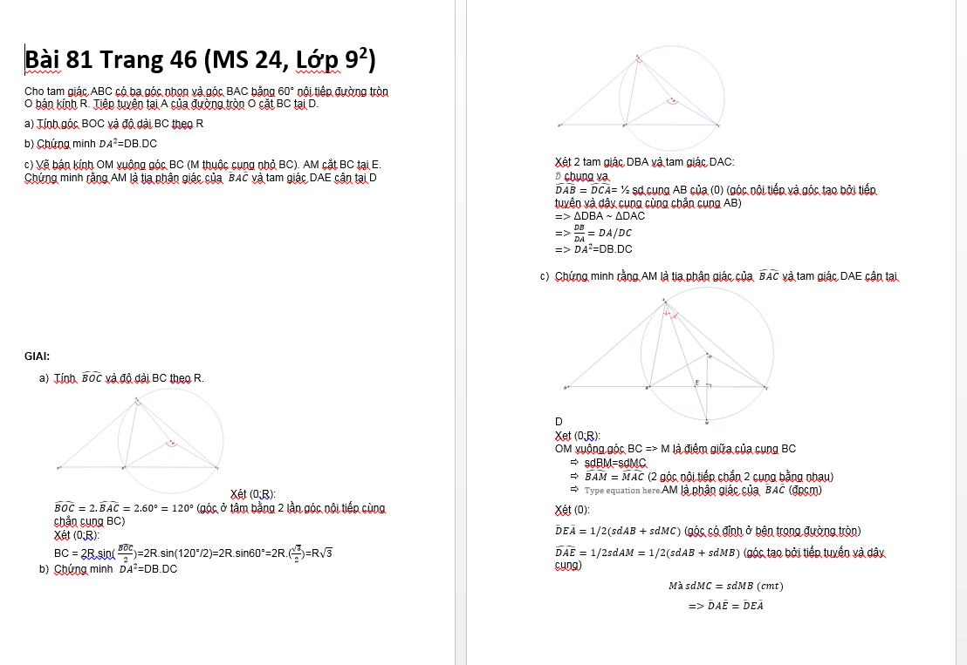
TINH SO DO GOC

Slide 25
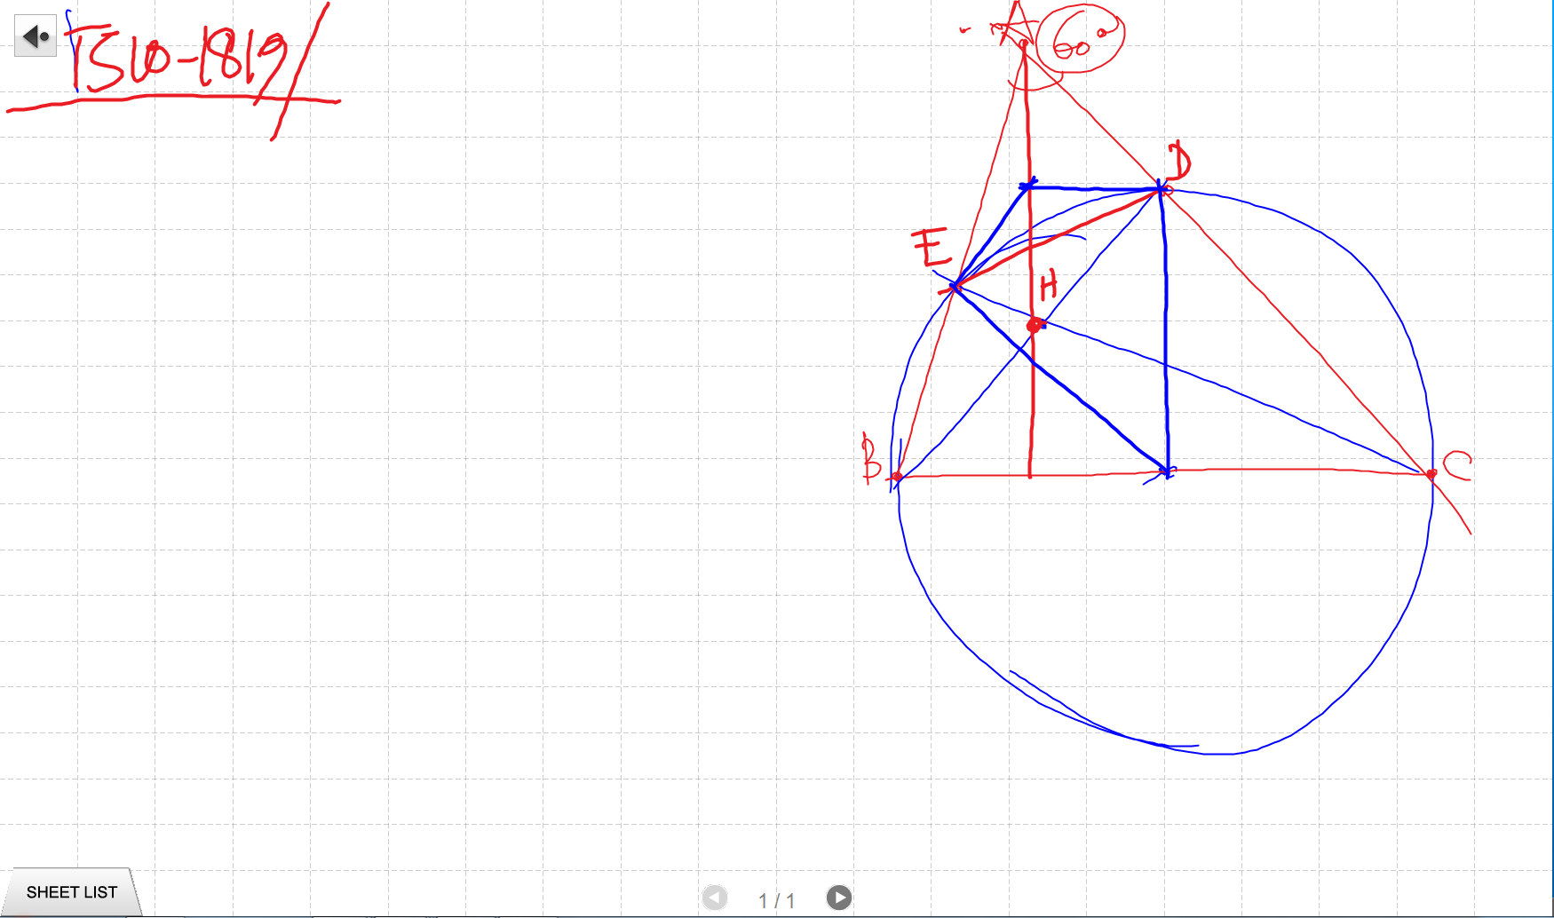
TINH SO DO GOC

Slide 26
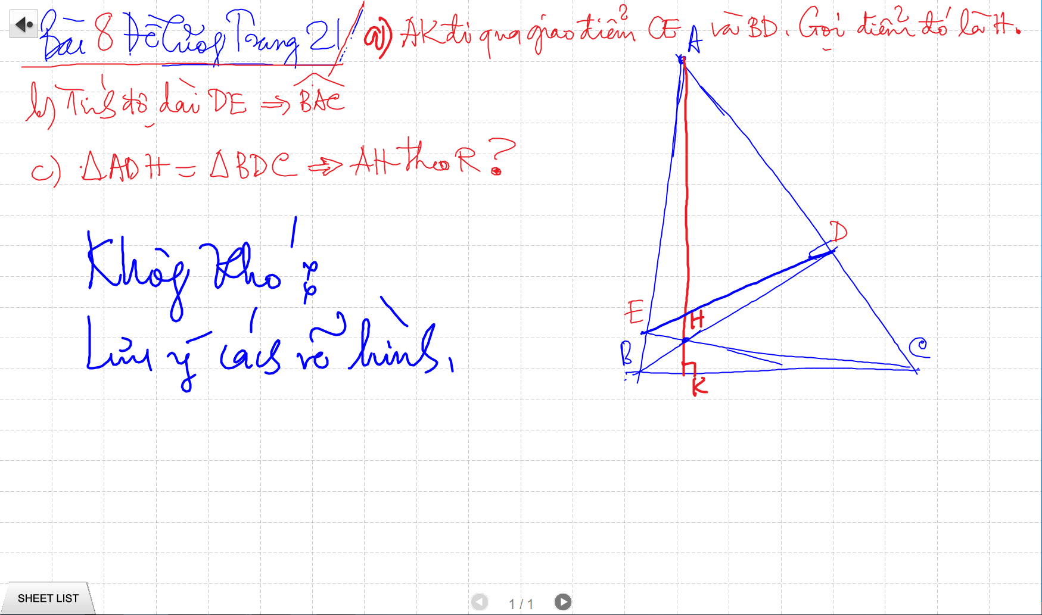
TINH SO DO GOC

Slide 27
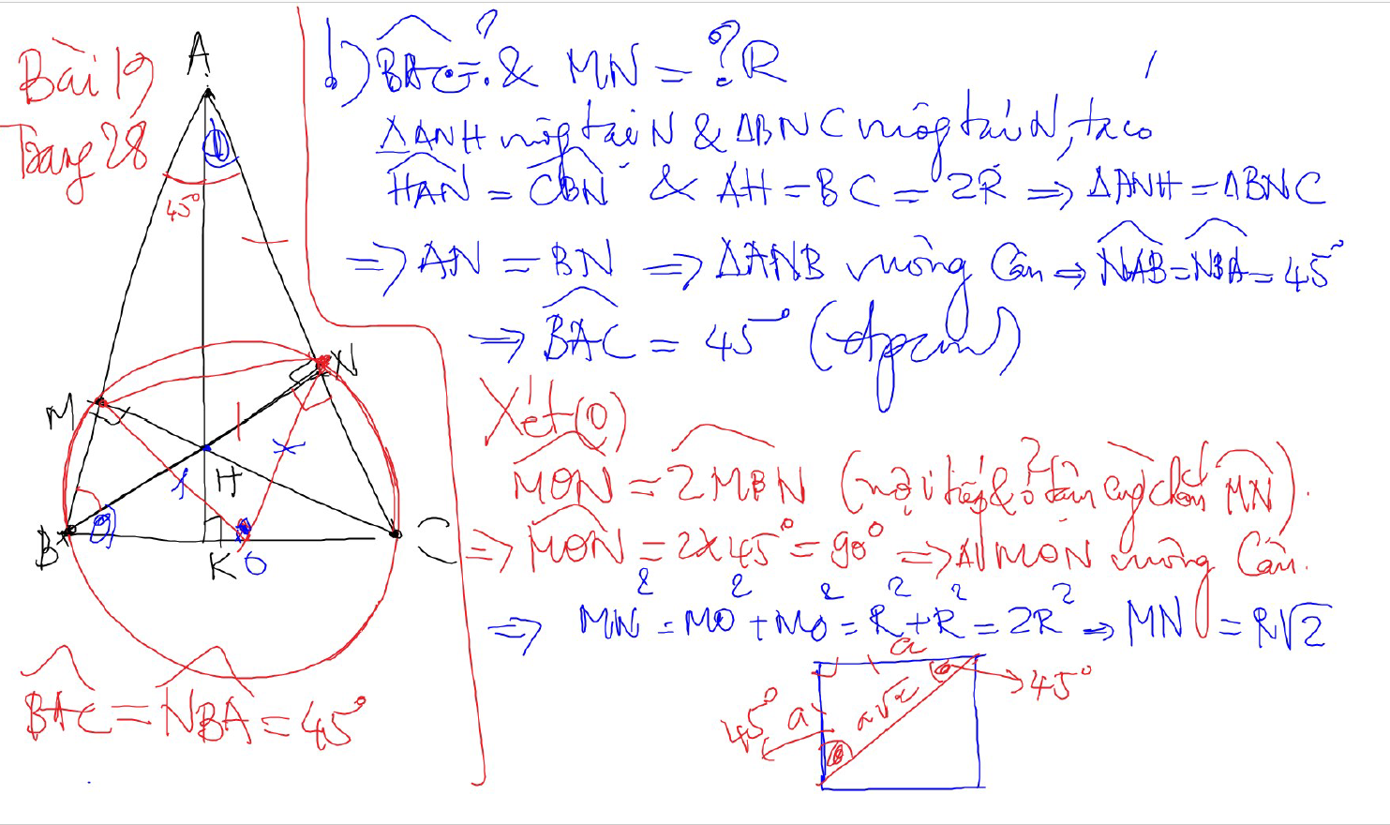
TINH SO DO GOC

Slide 28
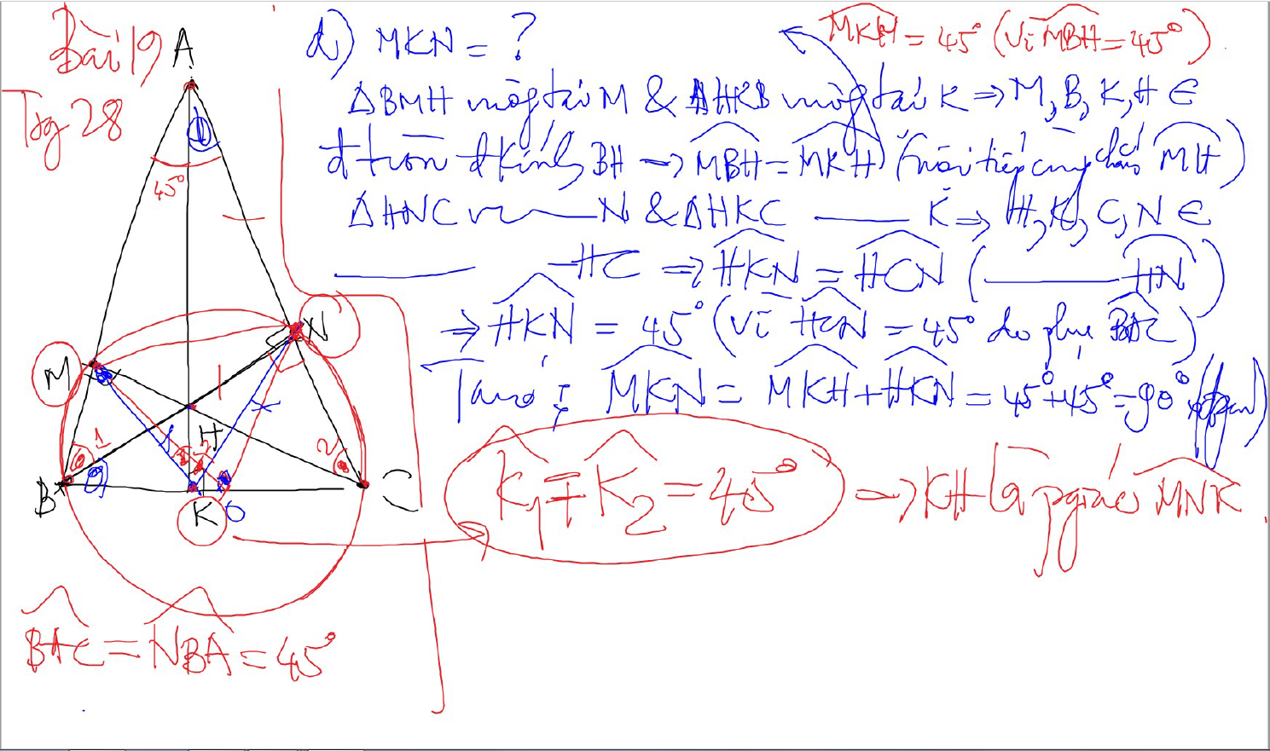
TINH SO DO GOC

Slide 29
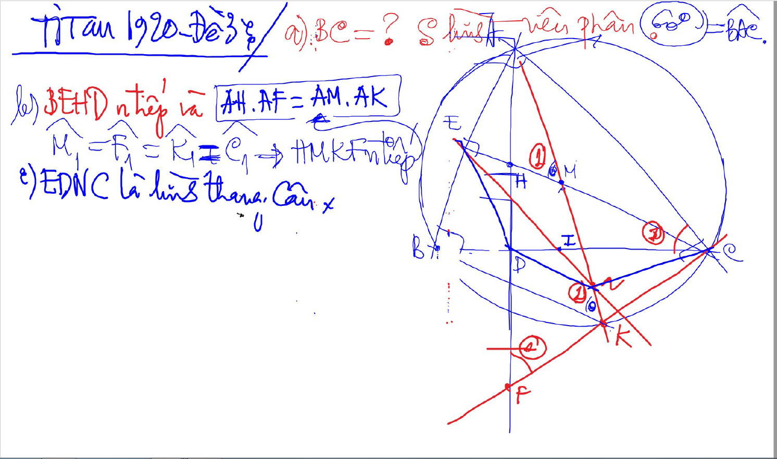
TINH SO DO GOC

Slide 30
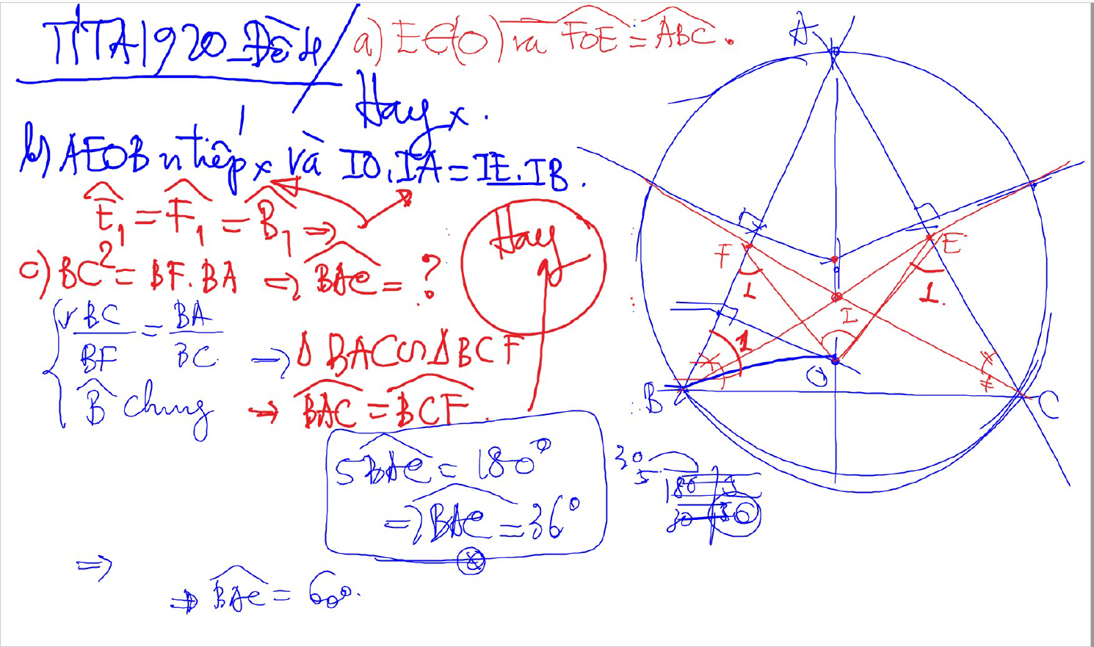
TINH SO DO GOC

Slide 31
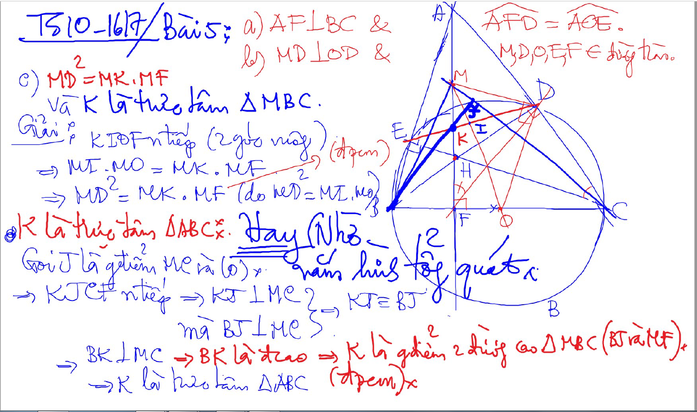
TINH SO DO GOC

Slide 32
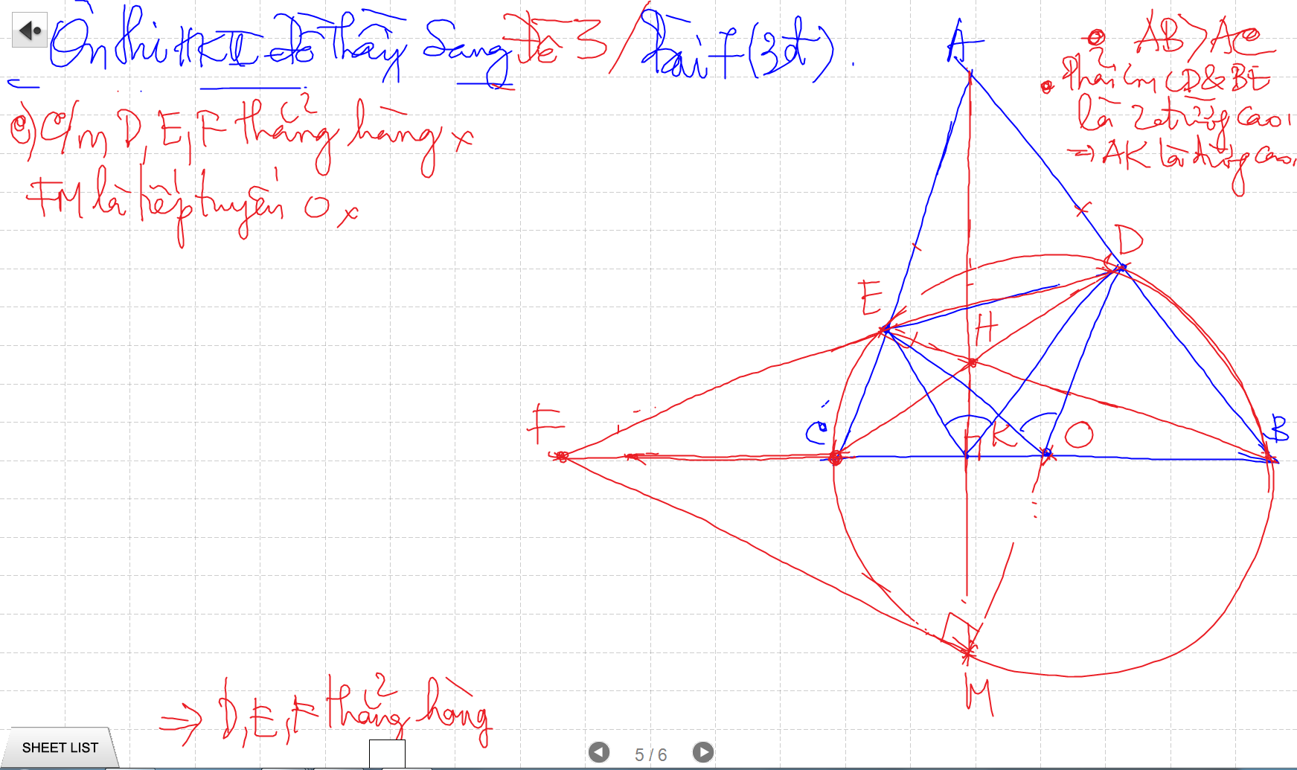
CHUNG MINH THANG HANG

Slide 33
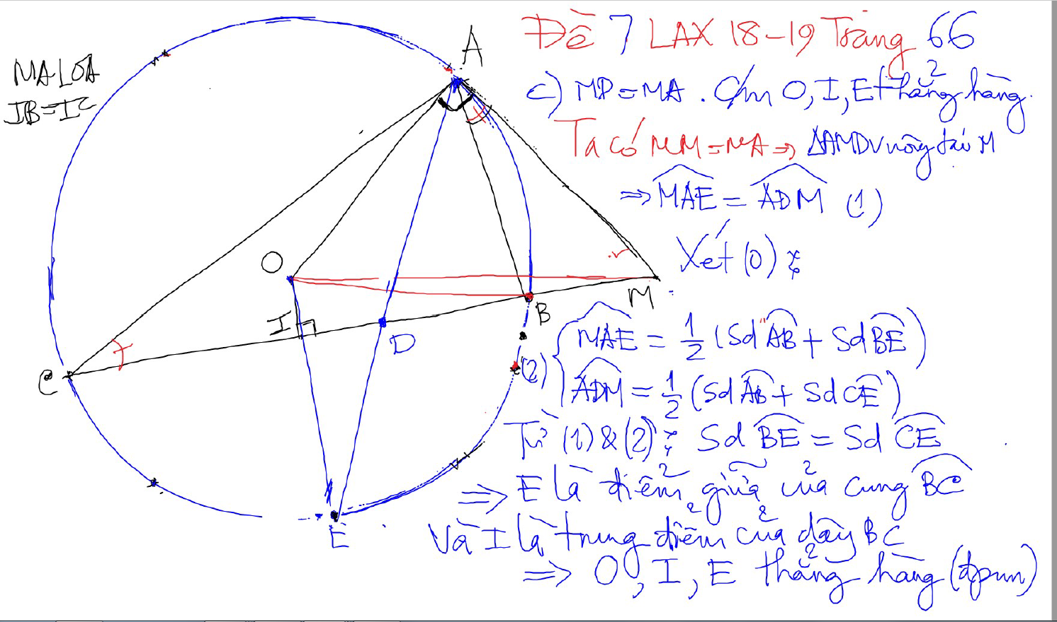
CHUNG MINH THANG HANG

Slide 34
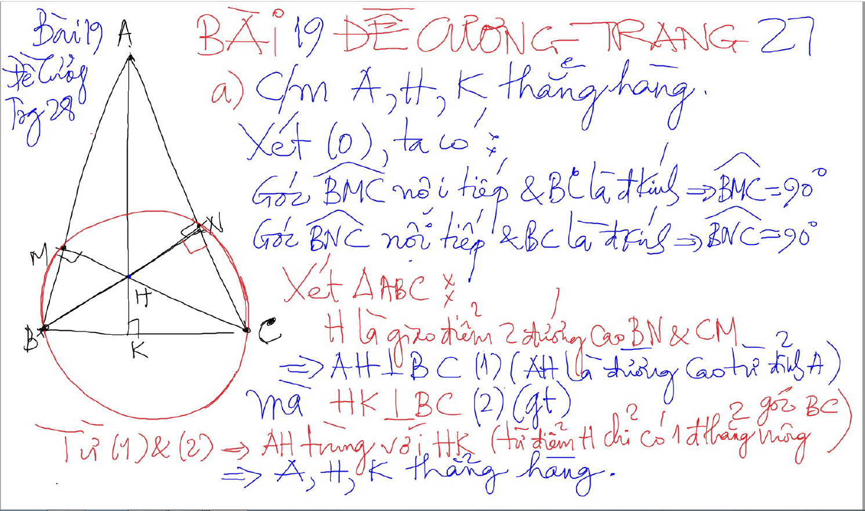
CHUNG MINH THANG HANG – 2 doan thang co 1 diem chung va cung vuong goc voi 1 dthang

Slide 35
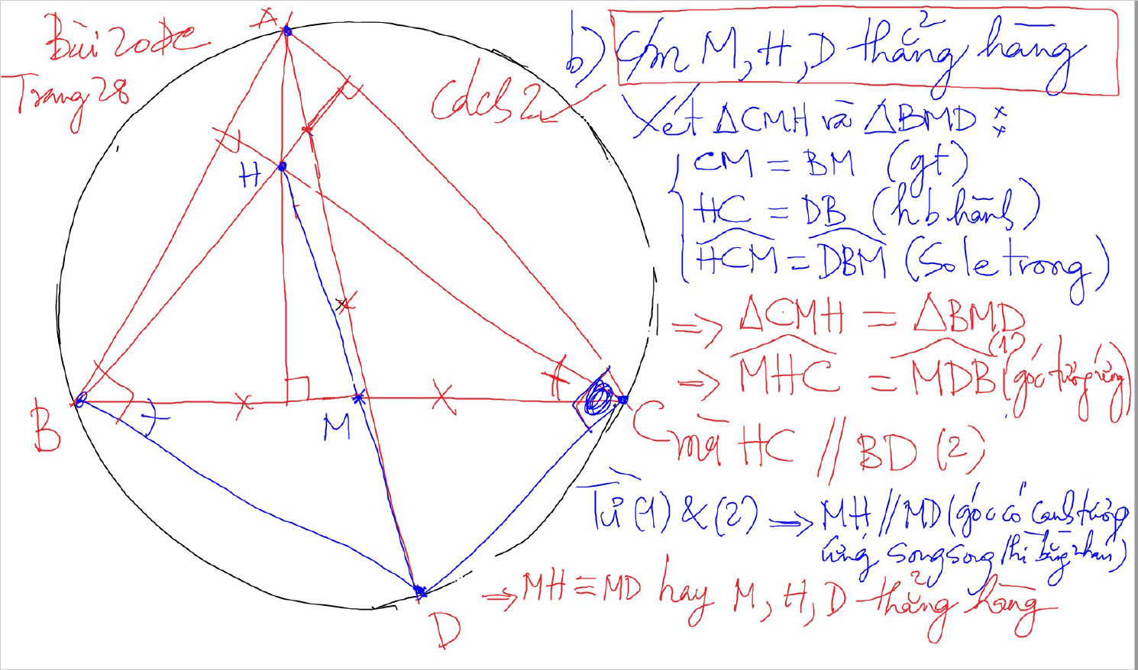
CHUNG MINH THANG HANG – 2 doan thang co mot diem chung va song song -> thang hang

Slide 36
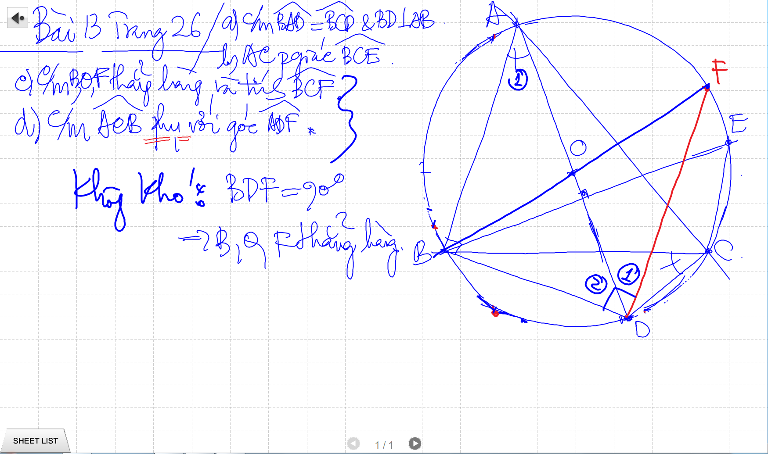
CHUNG MINH THANG HANG – Goc noi tiep ½ duong tron

Slide 37
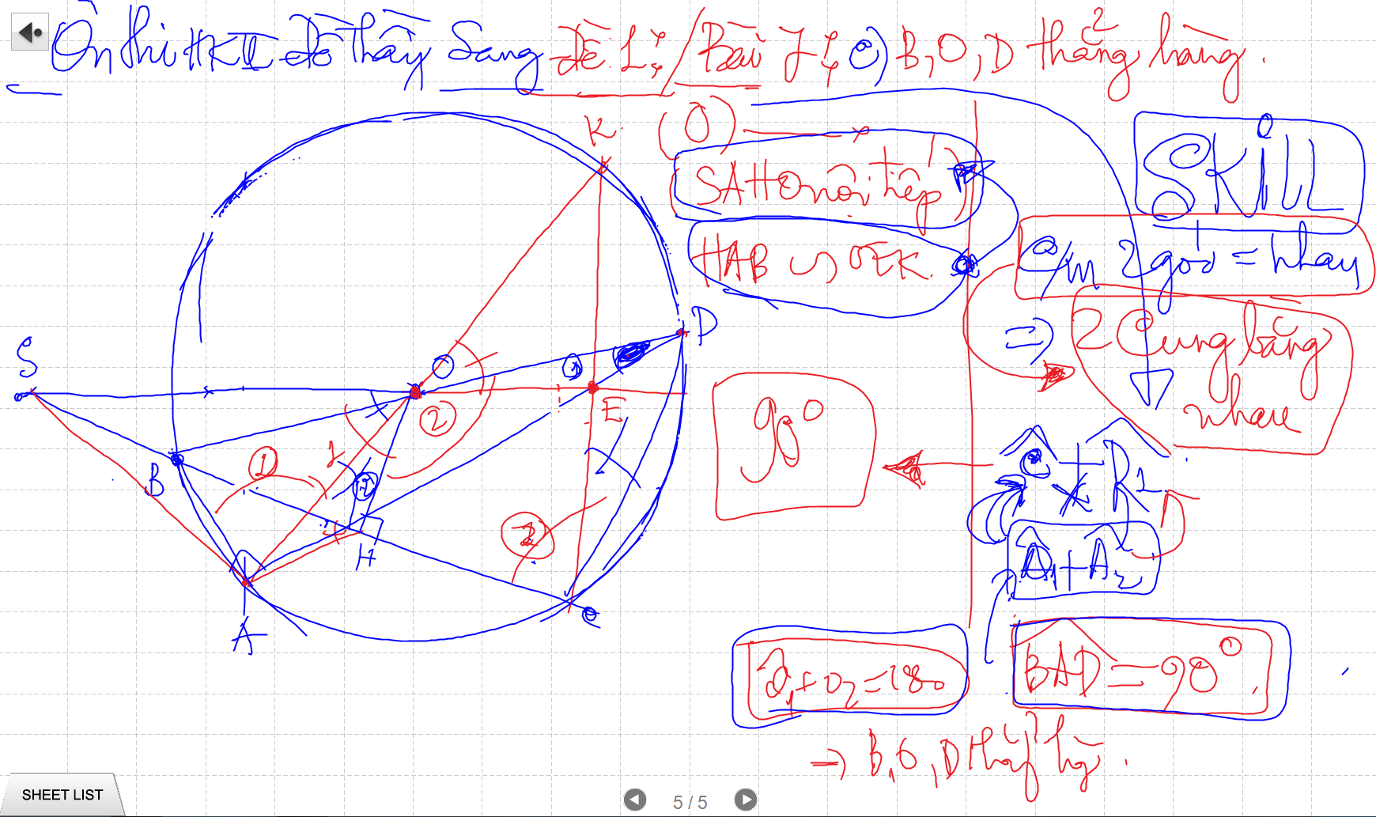
CHUNG MINH THANG HANG – Goc noi tiep ½ duong tron

Slide 38
CHUNG MINH THANG HANG – 2 doan thang co mot diem chung va song song -> thang hang

Slide 39
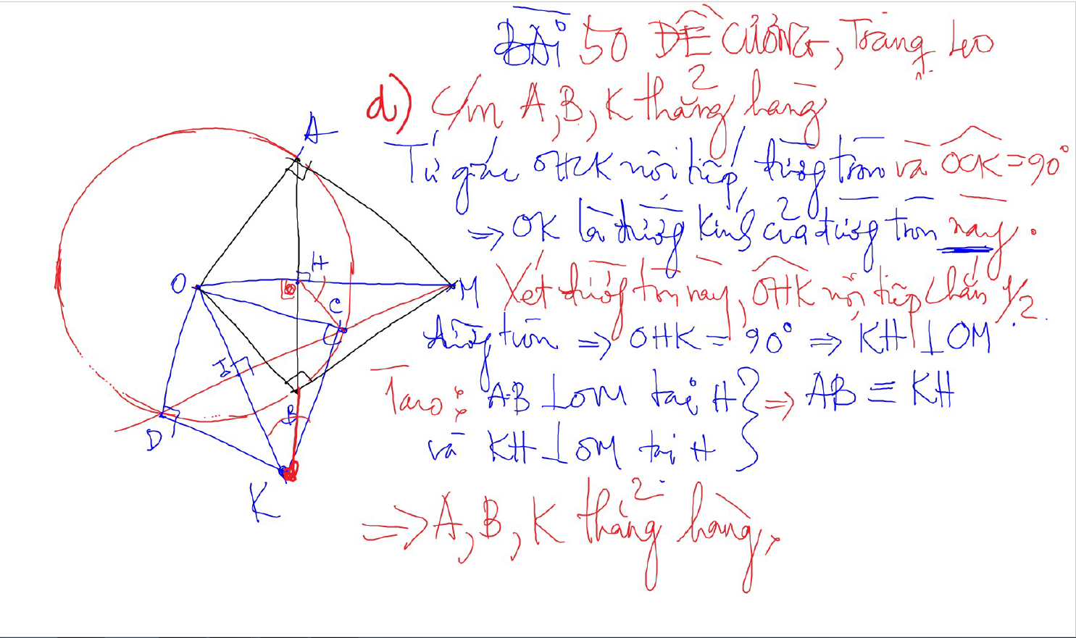
CHUNG MINH THANG HANG – 2 doan thang co 1 diem chung va cung vuong goc voi 1 dthang

Slide 40
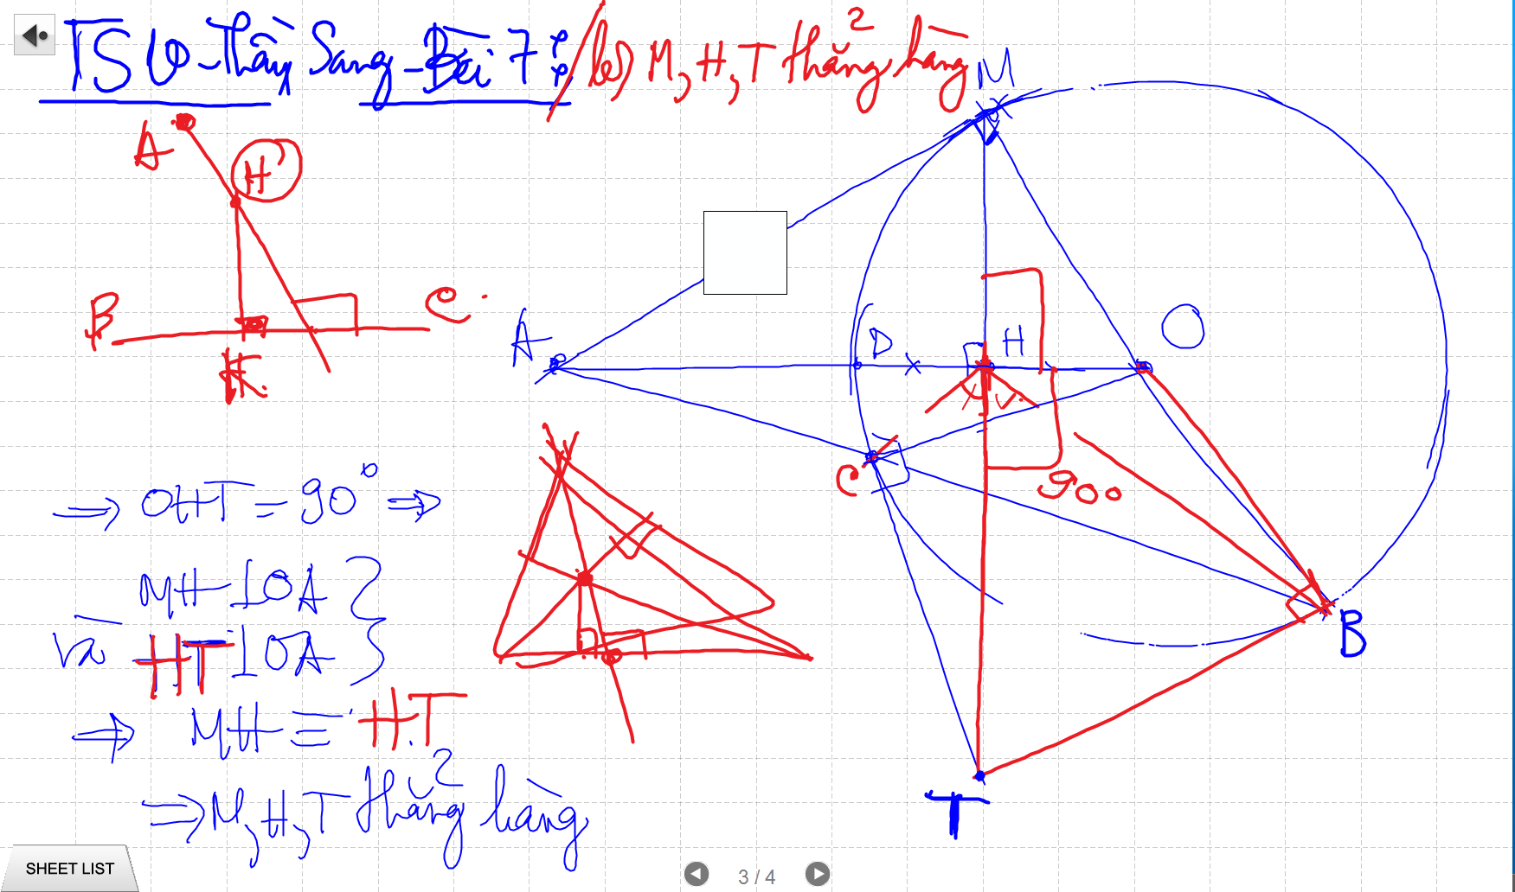
CHUNG MINH THANG HANG – 2 doan thang co 1 diem chung va cung vuong goc voi 1 dthang

Slide 41
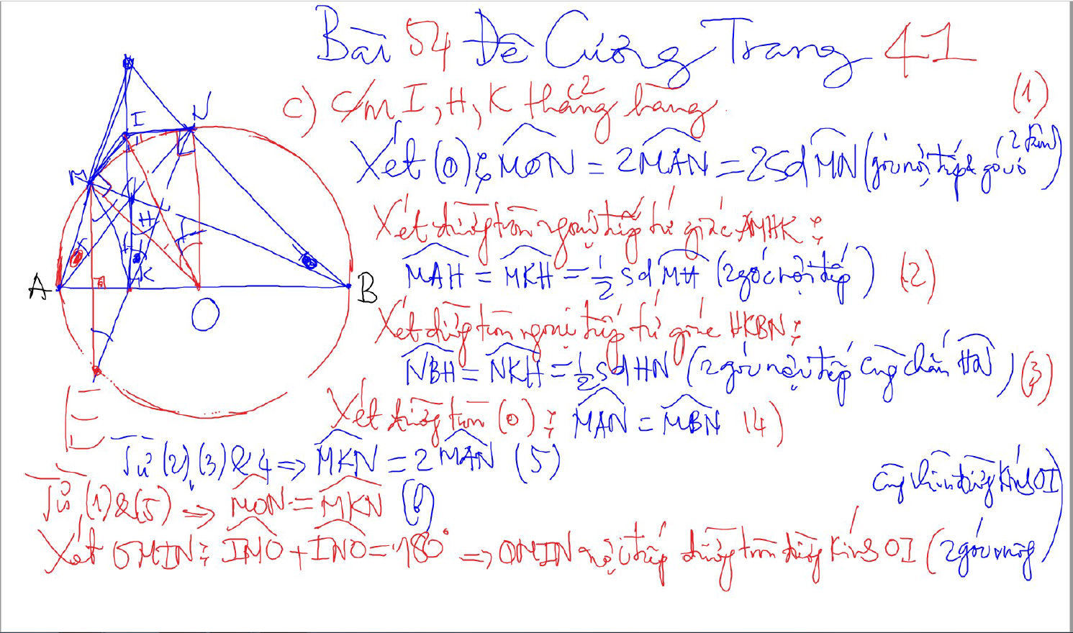
CHUNG MINH THANG HANG – 2 doan thang co 1 diem chung va cung vuong goc voi 1 dthang

Slide 42
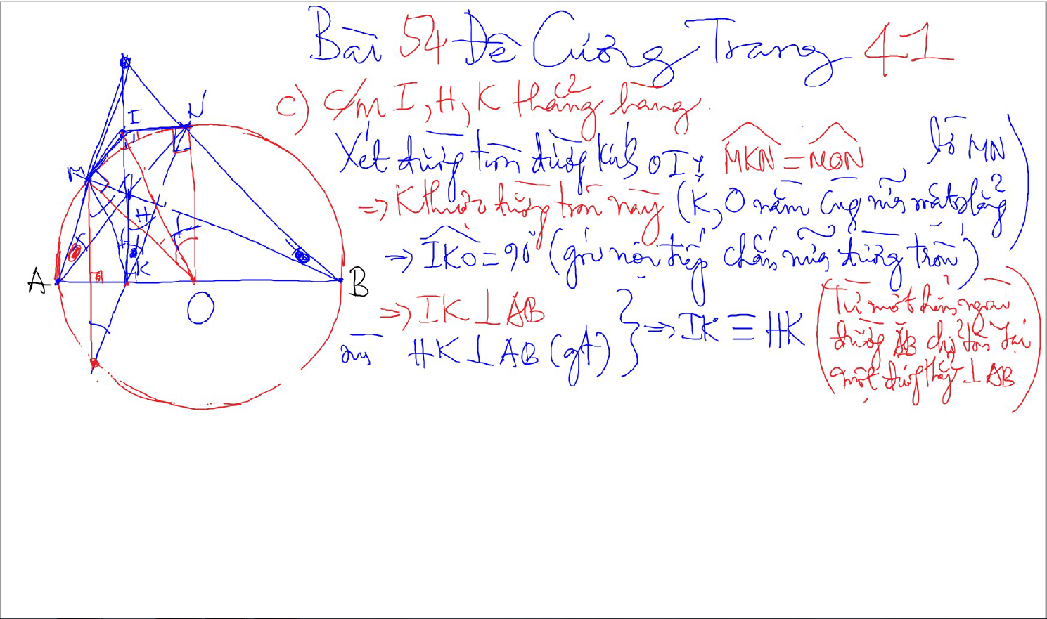
CHUNG MINH THANG HANG – 2 doan thang co 1 diem chung va cung vuong goc voi 1 dthang

Slide 43
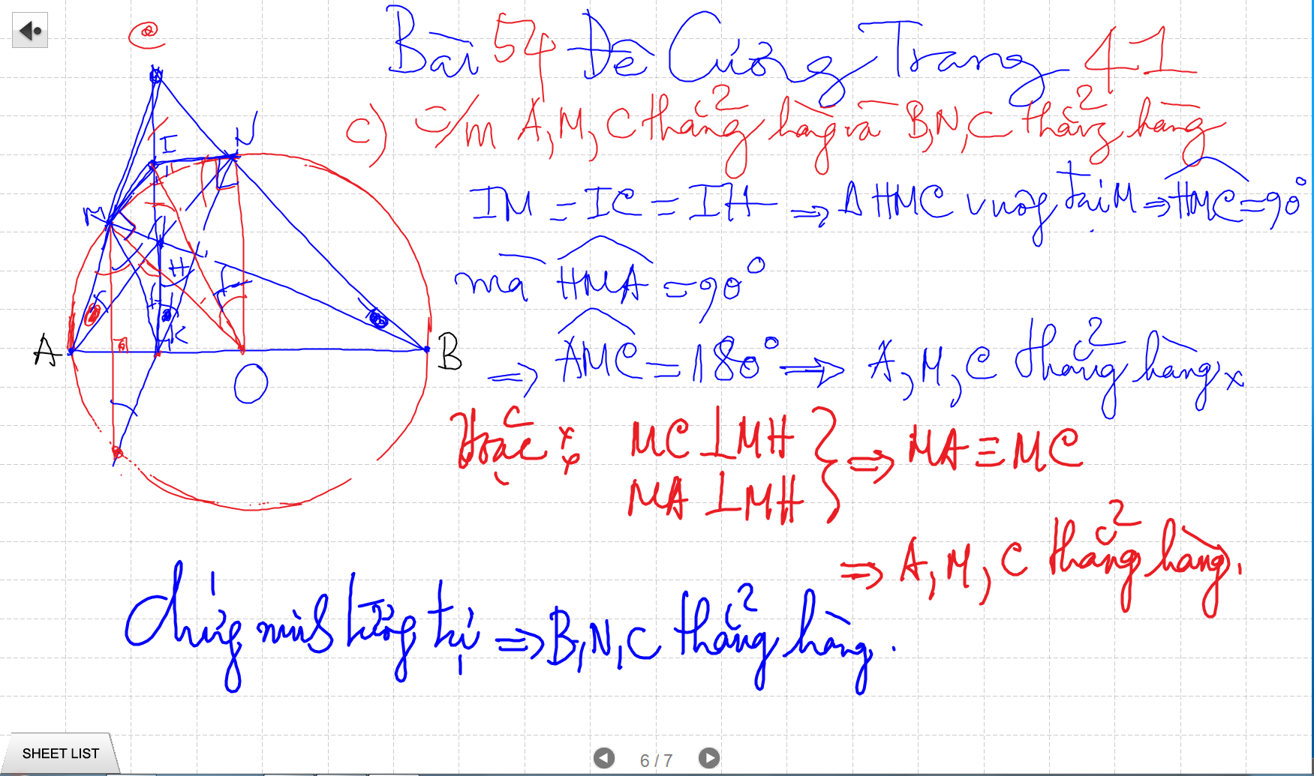
CHUNG MINH THANG HANG – 2 doan thang co 1 diem chung va cung vuong goc voi 1 dthang (2 goc ke bu)

Slide 44
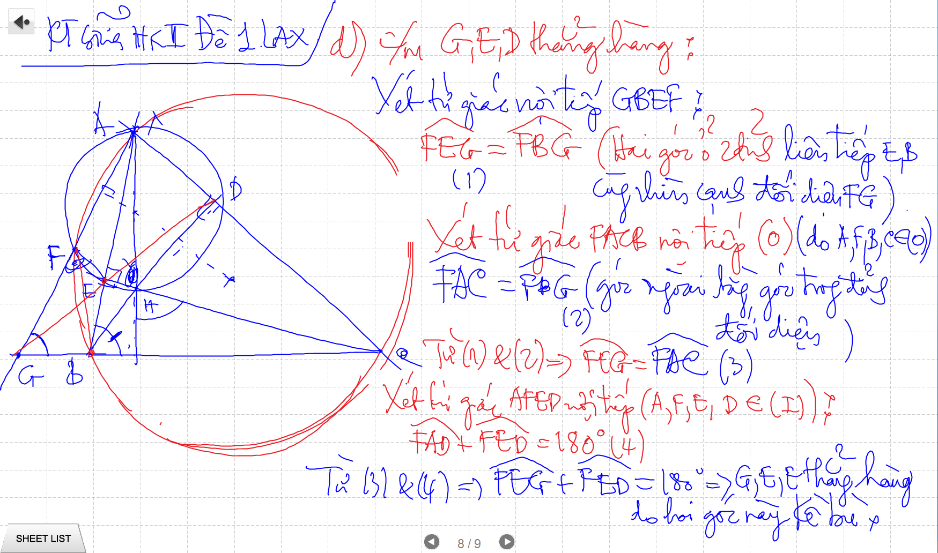
CHUNG MINH THANG HANG – 2 doan thang co 1 diem chung va cung vuong goc voi 1 dthang

Slide 45
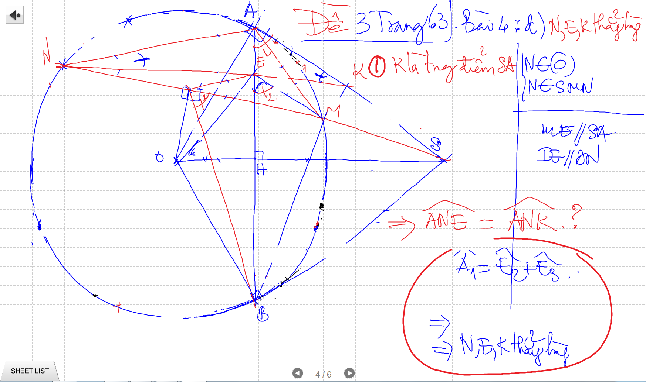
CHUNG MINH THANG HANG – 2 doan thang co 1 diem chung va cung vuong goc voi 1 dthang

Slide 46
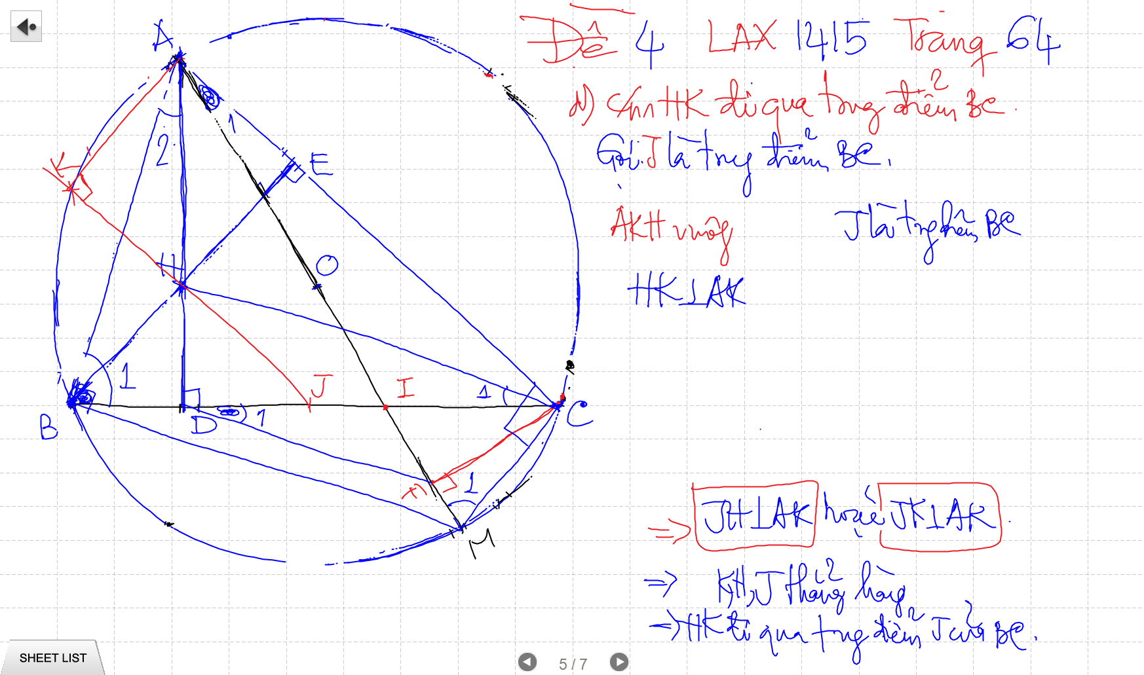
CHUNG MINH THANG HANG – 2 doan thang co 1 diem chung va cung vuong goc voi 1 dthang

Slide 47
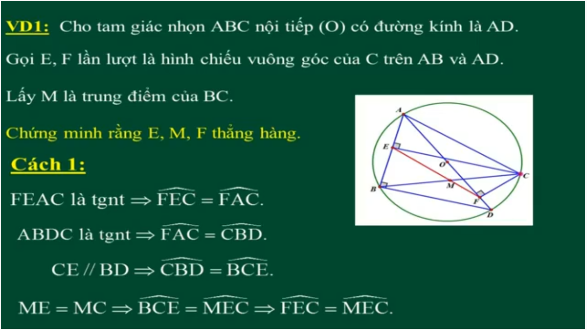
CHUNG MINH THANG HANG – 2 goc bang nhau co 1 canh chung

Slide 48
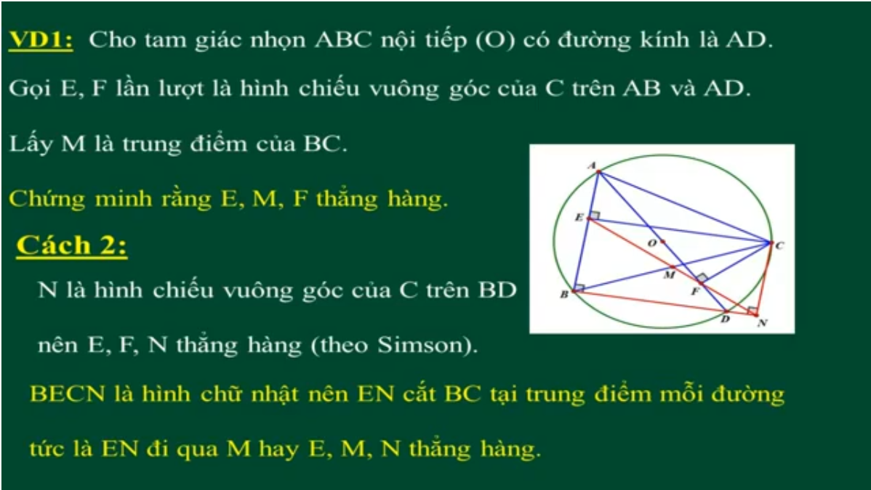
CHUNG MINH THANG HANG – 2 goc bang nhau co 1 canh chung

Slide 49
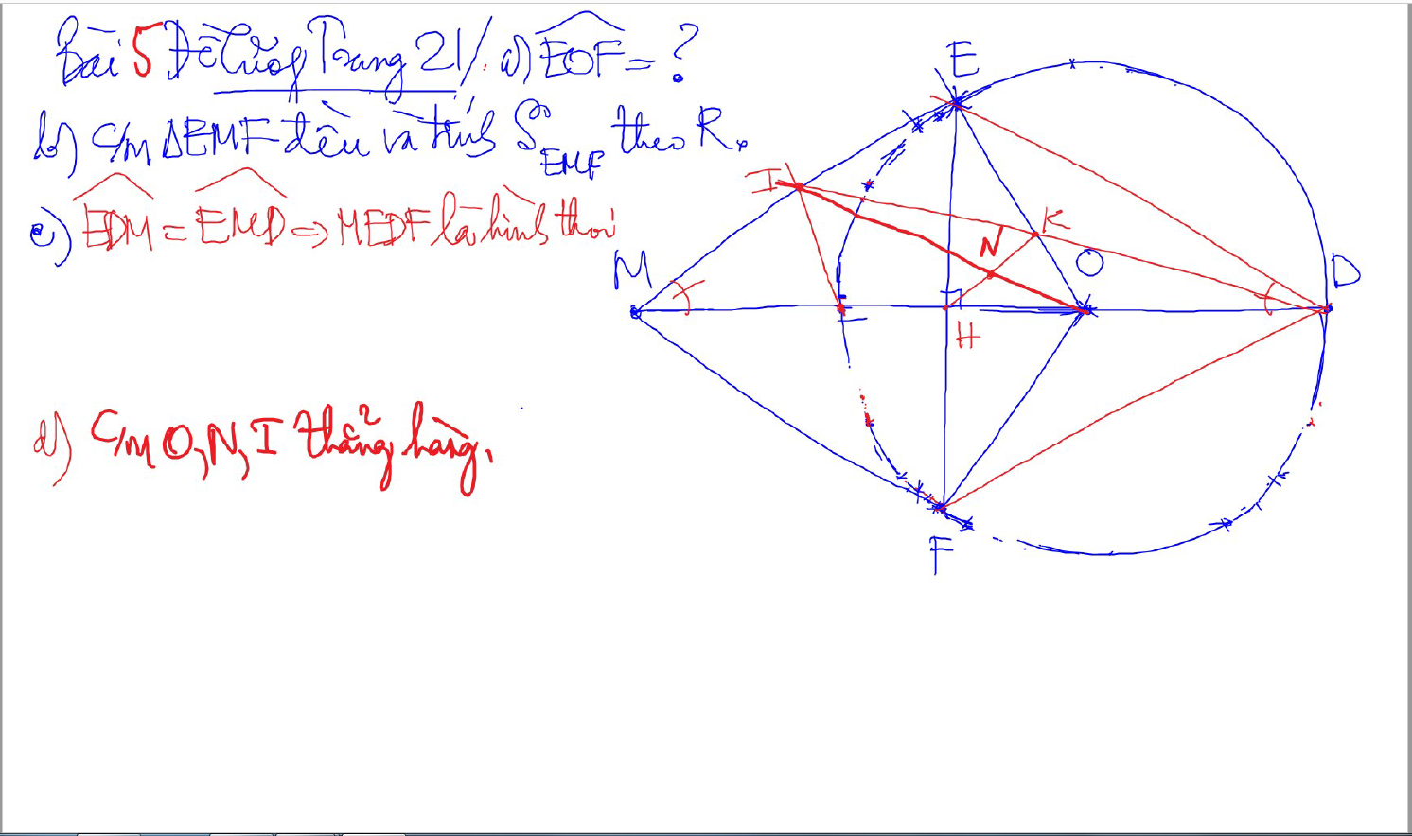
CHUNG MINH THANG HANG

Slide 50

CHUNG MINH THANG HANG – 2 doan thang co 1 diem chung va cung vuong goc voi 1 dthang

Slide 51

Đường thẳng SIMSON

Slide 52
CHUNG MINH THANG HANG – 2 doan thang co 1 diem chung va cung vuong goc voi 1 dthang

Slide 53
CHUNG MINH THANG HANG – 2 doan thang co 1 diem chung va cung vuong goc voi 1 dthang

